Slide 1

DISCRETE STRUCTURES
COURSE CODE:
MATH 103 / 121
LECTURE SLIDES ON GRAPHS
BY
MR. ANTHONY KWARTENG

Slide 2
A Graph
A graph G is a triple consisting of a vertex set V(G), an edge set E(G), and a relation that associates with each edge to two vertices called its endpoints.
It can also be referred as a pair of sets (V, E), where V is a non-empty set and called the set of vertices and the set E is called the set of edges (or lines).
Examples of graphs are shown below:
A
i. ii. iii.
P
1
B
C
Q
R
2
3
E
D
S

Slide 3
For any given graph G = (V, E), the sets V and E are assumed to be finite sets.
A vertex of a graph is called a node, a point; a junction or 0-cell.
An edge of a graph is called a line, a branch, a 1-cell or an arc.
Cardinality of Vertices(Nodes) and Edges
The cardinality of vertices or nodes in any given finite graph G, is denoted by |V| or (|V (G)|) or n(G) or simply n,
It determines the order of a finite graph, G.
Similarly, the number of edges in G (i.e. cardinality of edge) is denoted by |E| or (|E (G) |) or m(G) or simply m.

Slide 4
The cardinality of edges, |E| determines the size of the graph, G.
Example 1
Determine the order and the size of the ff graphs:
i. ii. iii.
Solutions
Let V and E denote the vertex and an edge of the above graphs
|V|= 6, hence the order of the graph is 6
|E| = 6, so the size is 6

Slide 5
ii. |V| = 5, so the order is 5
|E| = 7 and the size is 7
Try iii.
NB//:
The graph of order n and size m is referred too as an (n, m)-graph.
That’s if G is a (p, q) graph, then G has p vertices (points) and q edges
The degree of a vertex v in a graph G is the number of edges incident with the vertex in that graph, denoted deg Gv or simply deg v if G is clear from the context.

Slide 6
• A vertex is called even or odd depending on whether its degree is
even or odd.
• A vertex with degree 0 is called isolated vertex.
• A vertex with degree 1 is called an end-vertex or a pendant vertex
• The minimum degree of a graph G is the minimum among the
degrees of all the vertices of G, denoted 𝛿(G).
The maximum degree of G, denoted by Δ(G), is defined likewise.
• A graph with order 1 can have no edges.

Slide 7
Therefore there is only one graph of order 1, namely the graph consisting of a single isolated vertex.
This graph is called the trivial graph.
All other graphs are nontrivial.

Slide 8
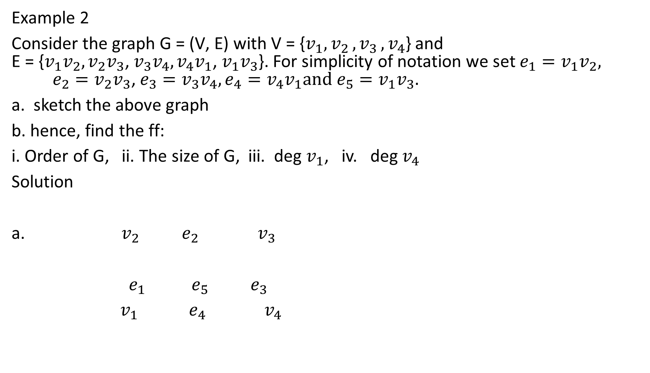
Example 2
Consider the graph G = (V‚ E) with V = {$v_{1}{,v}_{2}{,v}_{3}{,v}_{4}$} and E = {$v_{1}v_{2}, v_{2}v_{3}$, $v_{3}v_{4},v_{4}v_{1}$, $v_{1}v_{3}$}. For simplicity of notation we set $e_{1}=v_{1}v_{2}, e_{2}=v_{2}v_{3}\text{, }{e_{3}=v}_{3}v_{4},e_{4}=v_{4}v_{1}\text{and} {e_{5}=v}_{1}v_{3}.$
a. sketch the above graph
b. hence, find the ff:
i. Order of G, ii. The size of G, iii. deg $v_{1}$, iv. deg $v_{4}$
Solution
a. $v_{2}$ $e_{2}$ $v_{3}$
$e_{1}$ $e_{5}$ $e_{3}$
$v_{1}$ $e_{4}$ $v_{4}$

Slide 9
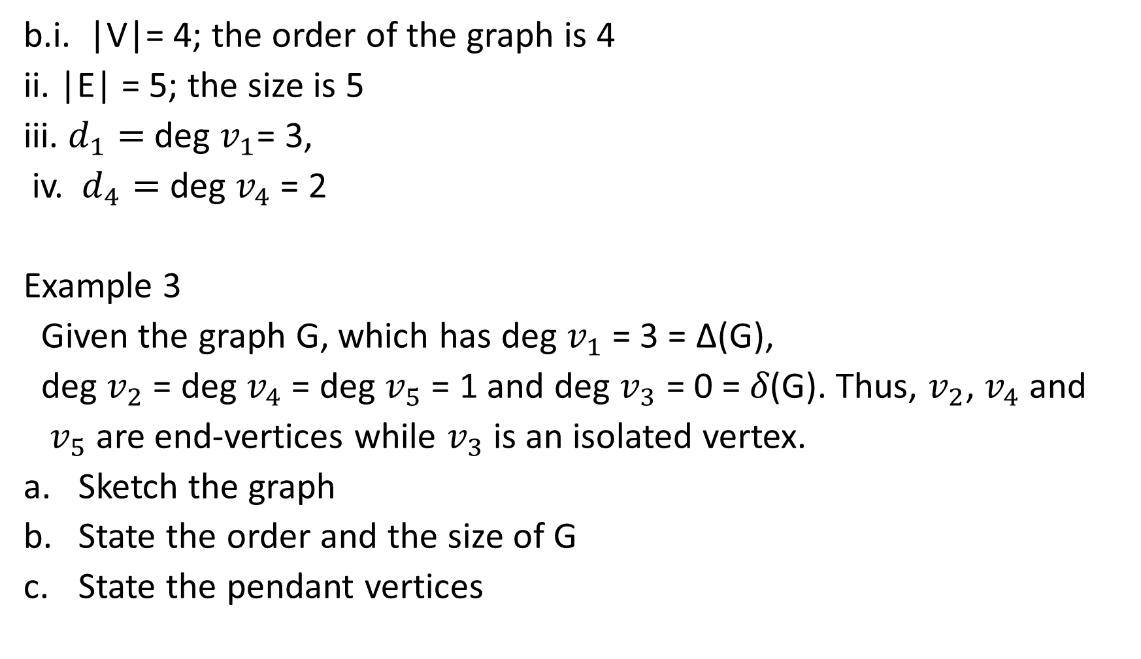
b.i. |V|= 4; the order of the graph is 4
ii. |E| = 5; the size is 5
iii. $d_{1}=$deg $v_{1}$= 3,
iv. $d_{4}=$ deg $v_{4}$ = 2
Example 3
Given the graph G, which has deg $v_{1}$ = 3 = Δ(G),
deg $v_{2}$ = deg $v_{4}$ = deg $v_{5}$ = 1 and deg $v_{3}$ = 0 = 𝛿(G). Thus, $v_{2}$, $v_{4}$ and
$v_{5}$ are end-vertices while $v_{3}$ is an isolated vertex.
Sketch the graph
State the order and the size of G
State the pendant vertices

Slide 10

Solutions:
a. $v_{1}$ $v_{2}$
$v_{3}$
$v_{4}$
$v_{5}$
b. |V|= n(G) = 5; the order of G is 5
|E| = m(G) = 3; the size of G is 3
the above graph is (5, 3) graph
c. The pendant or end vertices are $v_{2}, v_{4} and v_{5}$

Slide 11
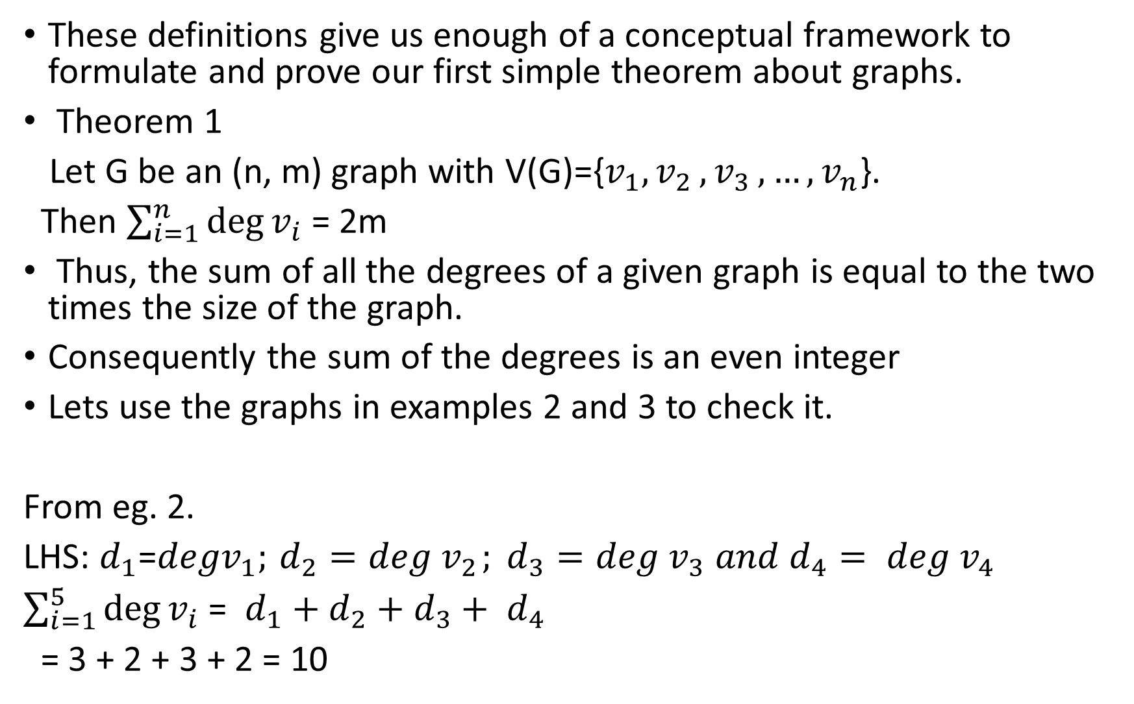
These definitions give us enough of a conceptual framework to formulate and prove our first simple theorem about graphs.
Theorem 1
Let G be an (n‚ m) graph with V(G)={$v_{1}{,v}_{2}{,v}_{3}{,…,v}_{n}$}.
Then $\sum_{i=1}^{n}{\deg{v_{i}}}$ = 2m
Thus, the sum of all the degrees of a given graph is equal to the two times the size of the graph.
Consequently the sum of the degrees is an even integer
Lets use the graphs in examples 2 and 3 to check it.
From eg. 2.
LHS: $d_{1}$=${degv}_{1};{ d_{2}=deg v}_{2}{; d_{3}=deg v}_{3}{ and d_{4}= deg v}_{4}$
$\sum_{i=1}^{5}{\deg{v_{i}}}$ = $d_{1}{+ d}_{2}{+ d}_{3}{+ d}_{4}$
= 3 + 2 + 3 + 2 = 10

Slide 12
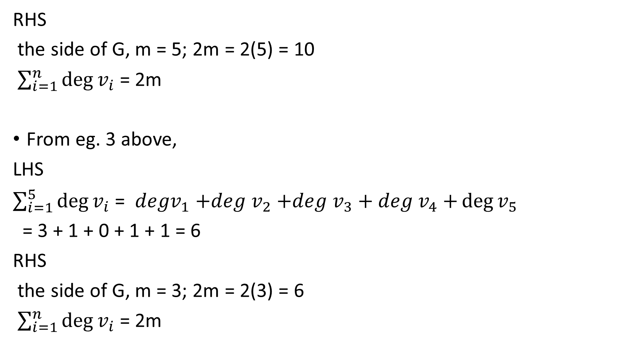
RHS
the side of G, m = 5; 2m = 2(5) = 10
$\sum_{i=1}^{n}{\deg{v_{i}}}$ = 2m
From eg. 3 above,
LHS
$\sum_{i=1}^{5}{\deg{v_{i}}}$ = ${degv}_{1}{+deg v}_{2}{+deg v}_{3}{+ deg v}_{4}+\deg{v_{5}}$
= 3 + 1 + 0 + 1 + 1 = 6
RHS
the side of G, m = 3; 2m = 2(3) = 6
$\sum_{i=1}^{n}{\deg{v_{i}}}$ = 2m

Slide 13
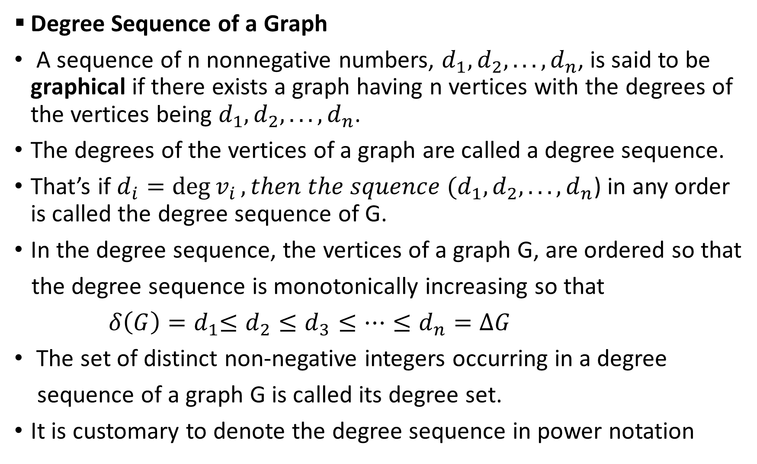
Degree Sequence of a Graph
A sequence of n nonnegative numbers, $d_{1}, d_{2}{, . . .,d}_{n}$, is said to be graphical if there exists a graph having n vertices with the degrees of the vertices being $d_{1}, d_{2}{, . . .,d}_{n}$.
The degrees of the vertices of a graph are called a degree sequence.
That’s if $d_{i}={\deg{v}}_{i}, then the squence (d_{1}, d_{2}{, . . .,d}_{n}$) in any order is called the degree sequence of G.
In the degree sequence, the vertices of a graph G, are ordered so that
the degree sequence is monotonically increasing so that
${ δ\left(G\right)=d}_{1}≤d_{2}≤d_{3}≤…≤d_{n}=∆G$
The set of distinct non-negative integers occurring in a degree
sequence of a graph G is called its degree set.
It is customary to denote the degree sequence in power notation

Slide 14

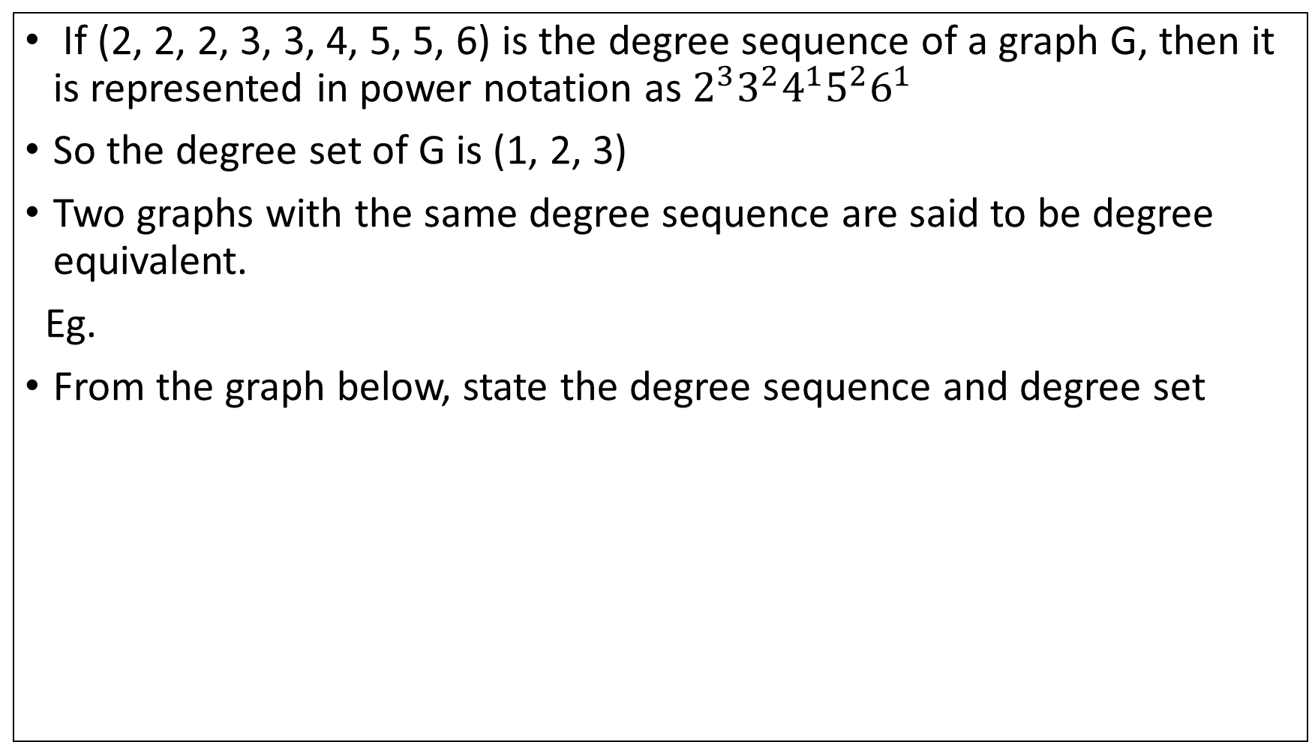


If (2, 2, 2, 3, 3, 4, 5, 5, 6) is the degree sequence of a graph G, then it is represented in power notation as $2^{3}3^{2}4^{1}5^{2}6^{1}$
So the degree set of G is (1, 2, 3)
Two graphs with the same degree sequence are said to be degree equivalent.
Eg.
From the graph below, state the degree sequence and degree set
$$v_{5}$$
$v_{1}$ $v_{2}$
$v_{3}$ $v_{4}$ $v_{6}$

Slide 15

We have d$d_{1}={\deg{v}}_{1}=0; d_{2}={\deg{v}}_{2}=1;d_{3}={\deg{v}}_{6}=1;d_{4}={\deg{v}}_{3}=2;$ $d_{5}={\deg{v}}_{4}=2;d_{5}={\deg{v}}_{5}$= 4.
The degree sequence of G is ${(d}_{1}, d_{2}{, . . .,d}_{5})=$ (0, 1, 1, 2, 2, 4).
It can expressed in power notation as, $0^{1}1^{2}2^{2}4^{1}$
Therefore, the power set is (1, 2)

Slide 16
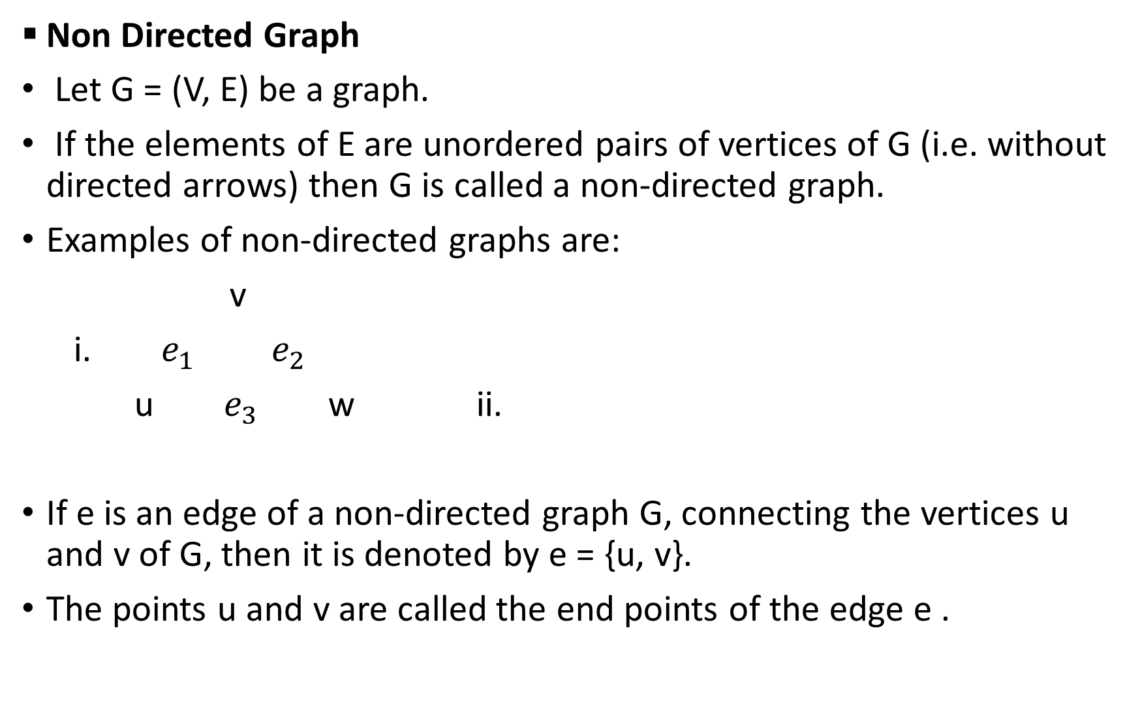
Non Directed Graph
Let G = (V, E) be a graph.
If the elements of E are unordered pairs of vertices of G (i.e. without directed arrows) then G is called a non-directed graph.
Examples of non-directed graphs are:
v
i. $e_{1} e_{2}$
u $e_{3}$ w ii.
If e is an edge of a non-directed graph G, connecting the vertices u and v of G, then it is denoted by e = {u, v}.
The points u and v are called the end points of the edge e .

Slide 17
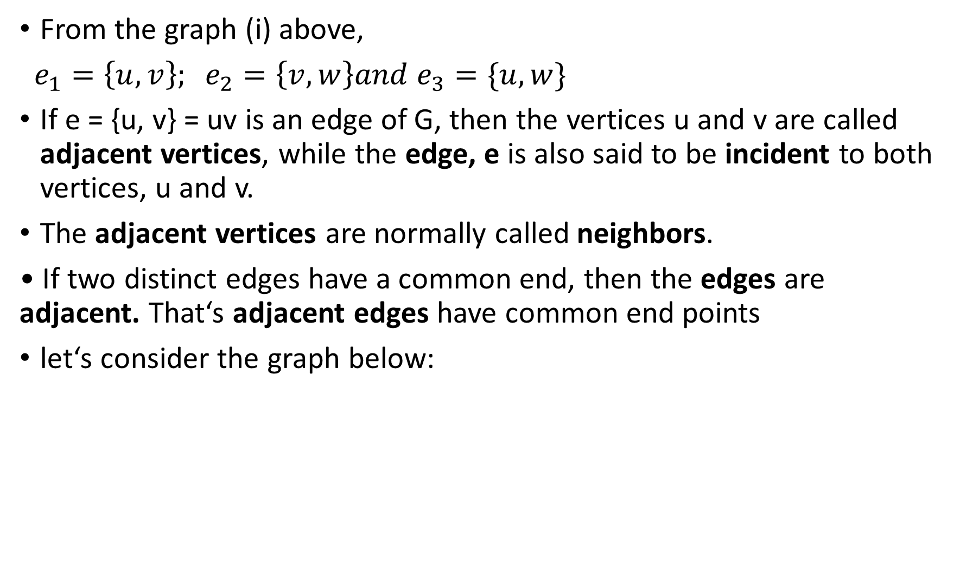
From the graph (i) above,
$e_{1}=\left\{u, v\right\}; e_{2}=\left\{v,w\right\}and e_{3}=\{u,w\}$
If e = {u, v} = uv is an edge of G, then the vertices u and v are called adjacent vertices, while the edge, e is also said to be incident to both vertices, u and v.
The adjacent vertices are normally called neighbors.
• If two distinct edges have a common end, then the edges are adjacent. That‘s adjacent edges have common end points
let‘s consider the graph below:

Slide 18









$$v_{1}$$
Adjacent Vertices
$$e_{4}$$
$$e_{1}$$
Adjacent Edges
$$v_{4}$$
$$v_{2}$$
$$e_{3}$$
$$e_{2}$$
$$v_{3}$$
$$e_{3} is incident to both vertices, v_{3} and v_{4}$$

Slide 19
Directed Graphs (Digraph)
Lets consider the graph G = (V, E).
If the elements of E are ordered pairs of vertices (i.e. e has arrows to indicate the starting point and the terminal point), then the graph G is called a directed graph.
If e is an edge of a directed graph G, denoted by e = (u, v), then e is a directed edge in G.
The vertex u is called the origin or initial point of the directed edge e and v is called the destination or terminal point of e.
Below are examples of digraphs:

Slide 20
i. ii.
iii.

Slide 21

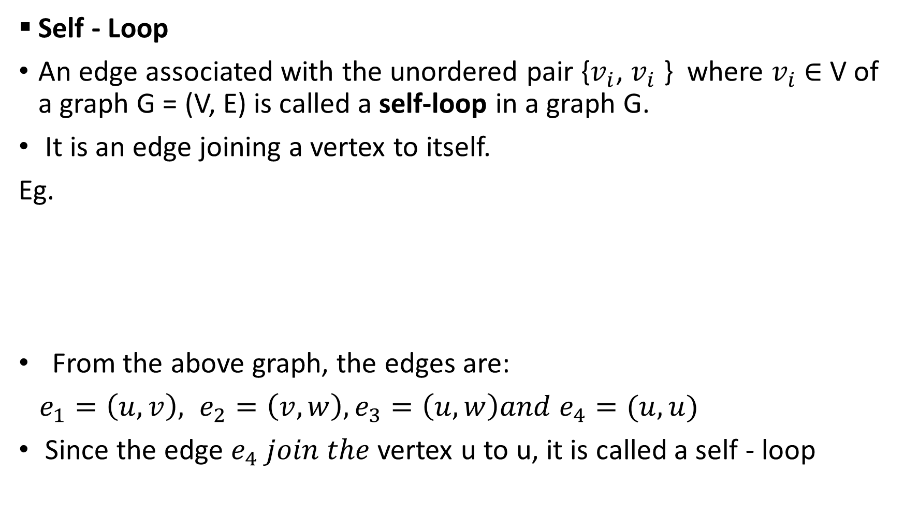



Self - Loop
An edge associated with the unordered pair {$v_{i}$, $v_{i}$ } where $v_{i}$ ∈ V of a graph G = (V, E) is called a self-loop in a graph G.
It is an edge joining a vertex to itself.
Eg.
From the above graph, the edges are:
$e_{1}=\left(u, v\right), e_{2}=\left(v,w\right), e_{3}=\left(u, w\right)and e_{4}=(u, u)$
Since the edge $e_{4} join the$vertex u to u, it is called a self - loop
v
$$e_{1}$$
$$e_{2}$$
$$e_{4}$$
u
$$e_{3}$$
w

Slide 22



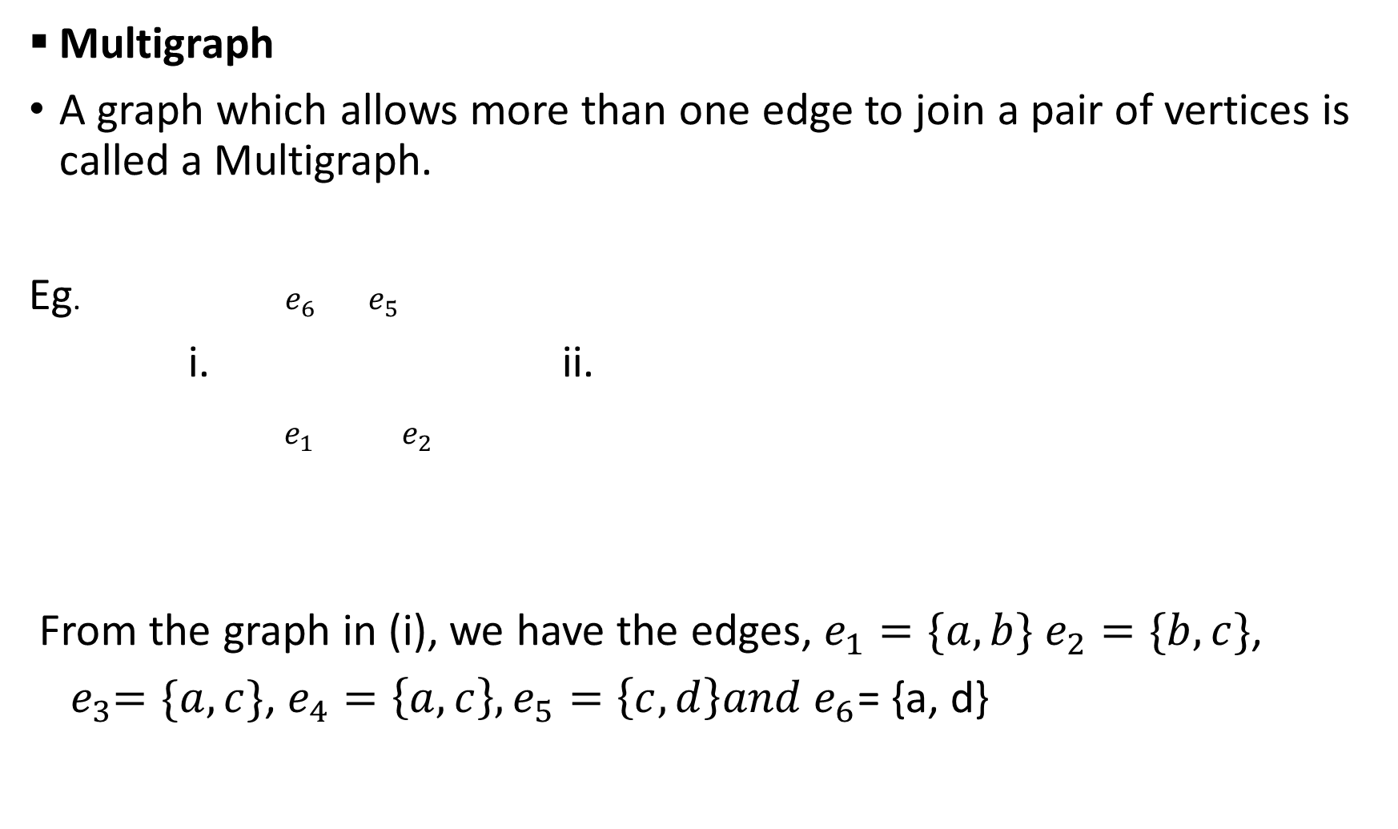





Multigraph
A graph which allows more than one edge to join a pair of vertices is called a Multigraph.
Eg. $e_{6}$ $e_{5}$
i. ii.
$e_{1} { e}_{2}$
From the graph in (i), we have the edges, $e_{1}=\{a,b\} e_{2}=\{b,c\}$,
${ e}_{3}=\{a,c\}$, $e_{4}=\left\{a,c\right\}, e_{5}=\left\{c,d\right\}and e_{6}$= {a, d}
d
w
Q dd
$e_{1}$ $e_{2}$
$$e_{4}$$
a
$$e_{3}$$
c
x
$$e_{7}$$
z
$$e_{5}$$
$$e_{6}$$
$$e_{3}$$
$$e_{4}$$
b
y

Slide 23
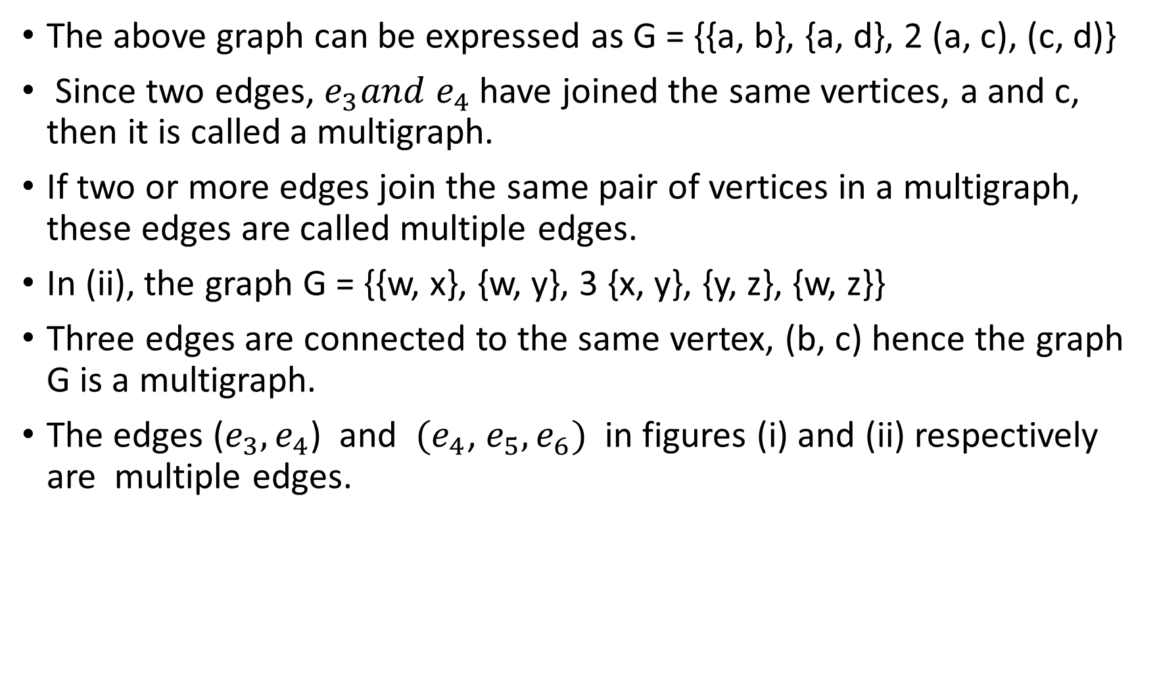
The above graph can be expressed as G = {{a, b}, {a, d}, 2 (a, c), (c, d)}
Since two edges, $e_{3}{and e}_{4}$ have joined the same vertices, a and c, then it is called a multigraph.
If two or more edges join the same pair of vertices in a multigraph, these edges are called multiple edges.
In (ii), the graph G = {{w, x}, {w, y}, 3 {x, y}, {y, z}, {w, z}}
Three edges are connected to the same vertex, (b, c) hence the graph G is a multigraph.
The edges ($e_{3}, e_{4}$) and ${(e}_{4}$, $e_{5}, e_{6})$ in figures (i) and (ii) respectively are multiple edges.

Slide 24
A Simple Graph
A graph G with no self-loops is called a simple graph.
Examples:

Slide 25



Null Graph:
A graph G = (V, E) in which the set of edges E is empty (i.e. a graph without edges) is called a Null graph.
Eg. .
. .
Weighted Graphs
A graph G in which weight are assigned to every edge is called a weighted graph.
$$v_{1}$$
$$v_{3}$$
$$v_{2}$$

Slide 26
Eg.
i. ii.
d
4
c
3
f
5
g
3
3
5
4
6
a
b
4
d
4
c
4
4
a
4
b

Slide 27
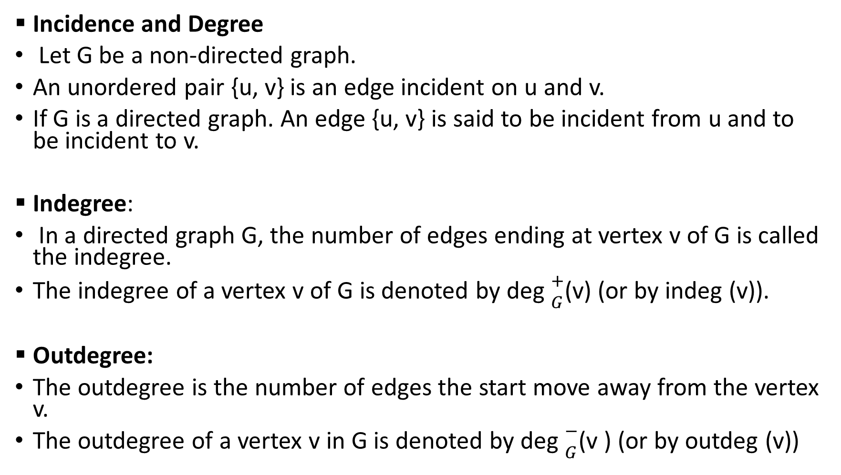
Incidence and Degree
Let G be a non-directed graph.
An unordered pair {u, v} is an edge incident on u and v.
If G is a directed graph. An edge {u, v} is said to be incident from u and to be incident to v.
Indegree:
In a directed graph G, the number of edges ending at vertex v of G is called the indegree.
The indegree of a vertex v of G is denoted by deg ${+ \atop G}$(v) (or by indeg (v)).
Outdegree:
The outdegree is the number of edges the start move away from the vertex v.
The outdegree of a vertex v in G is denoted by deg ${− \atop G}$(v ) (or by outdeg (v))

Slide 28





Lets consider the digraph G below:
The indegree of $v_{1}$ is 1 and the outdegree is 2
The indegree of $v_{2}$ is 2 and the outdegree is 1
State the indegree and outdegree for both $v_{3} and v_{4}$
3
$$v_{4}$$
$$v_{1}$$
$$v_{3}$$
3
$$v_{2}$$
3

Slide 29




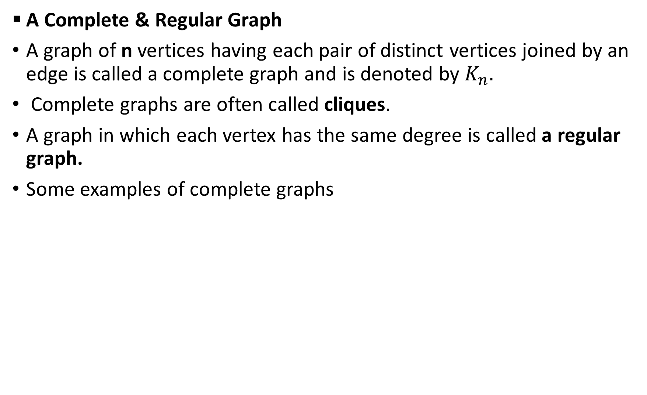
A Complete & Regular Graph
A graph of n vertices having each pair of distinct vertices joined by an edge is called a complete graph and is denoted by $K_{n}.$
Complete graphs are often called cliques.
A graph in which each vertex has the same degree is called a regular graph.
Some examples of complete graphs
$$K_{1}$$
$$K_{2}$$
$$K_{3}$$
$$K_{4}$$

Slide 30


.
Some examples of regular graphs
$$K_{5}$$
$$K_{6}$$
2- regular
3 - regular
4 - regular

Slide 31
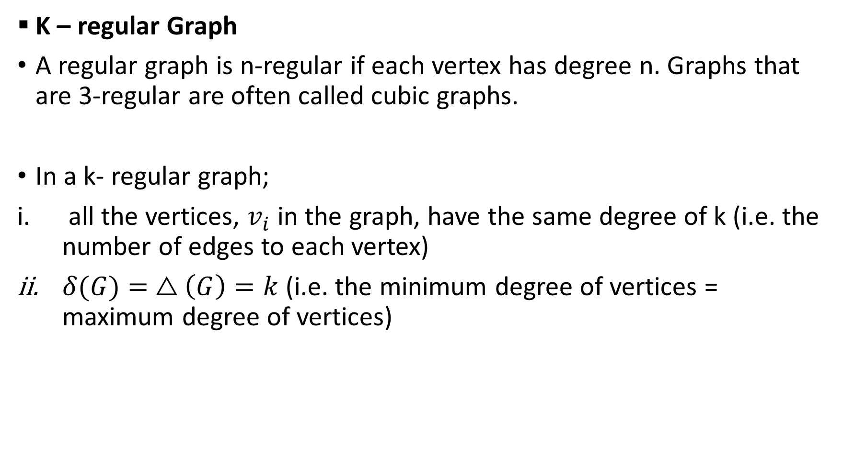
K – regular Graph
A regular graph is n-regular if each vertex has degree n. Graphs that are 3-regular are often called cubic graphs.
In a k- regular graph;
all the vertices, $v_{i}$ in the graph, have the same degree of k (i.e. the number of edges to each vertex)
$δ(G)= △\left(G\right)=k$ (i.e. the minimum degree of vertices = maximum degree of vertices)

Slide 32
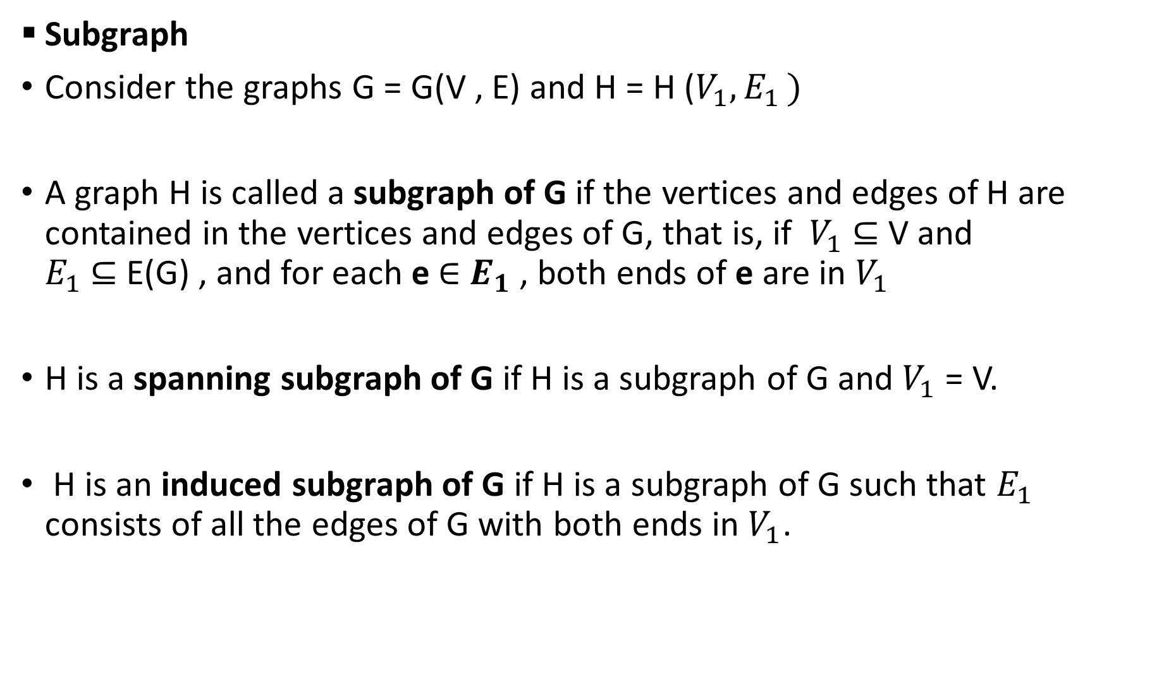
Subgraph
Consider the graphs G = G(V , E) and H = H ($V_{1}{,E}_{1})$
A graph H is called a subgraph of G if the vertices and edges of H are contained in the vertices and edges of G, that is, if $V_{1}$ ⊆ V and $E_{1}$ ⊆ E(G) , and for each e $∈$ $E_{1}$ , both ends of e are in $V_{1}$
H is a spanning subgraph of G if H is a subgraph of G and $V_{1}$ = V.
H is an induced subgraph of G if H is a subgraph of G such that $E_{1}$ consists of all the edges of G with both ends in $V_{1}$.

Slide 33
If v is a vertex in G, then G − v is the subgraph of G obtained by deleting v from G and deleting all edges in G which contain v.
If e is an edge in G, then G − e is the subgraph of G obtained by simply deleting the edge e from G.
Lets consider some examples of different kinds of subgraph:
1
2
3
4
Graph G Subgraph H of G
1
6
2
5
3
4

Slide 34
1
1 6
2 5 2
4
3 4 3
<{1, 2, 3, 4}> Spanning Subgraph of G
Induced Subgraph of G

Slide 35
Computer Representation of Graphs
The methods commonly used for representing graphs (other than drawing a picture or just listing the vertices and edges) are:
Adjacency Matrix
Incidence Matrix
Adjacency List.
These methods lead to widely used computer representations of a graph.
In some applications, the order of the complexity of the algorithm will even depend on which representation is used

Slide 36
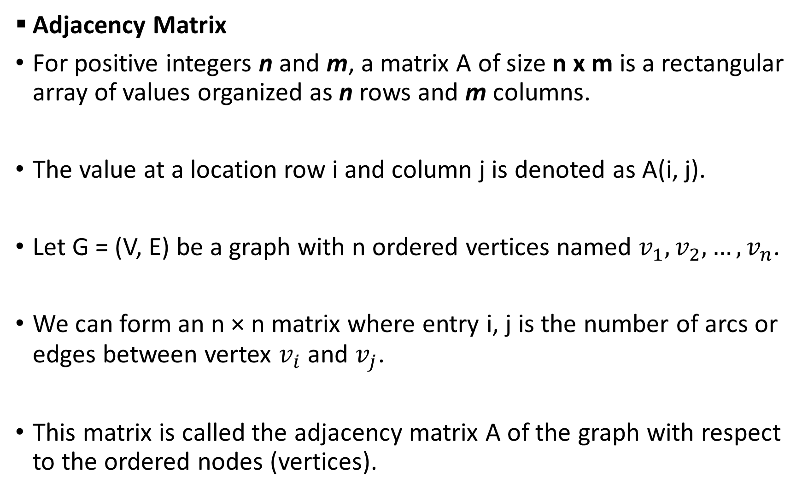
Adjacency Matrix
For positive integers n and m, a matrix A of size n x m is a rectangular array of values organized as n rows and m columns.
The value at a location row i and column j is denoted as A(i, j).
Let G = (V, E) be a graph with n ordered vertices named $v_{1},v_{2}{,…,v}_{n}$.
We can form an n × n matrix where entry i, j is the number of arcs or edges between vertex $v_{i}$ and $v_{j}$.
This matrix is called the adjacency matrix A of the graph with respect to the ordered nodes (vertices).

Slide 37
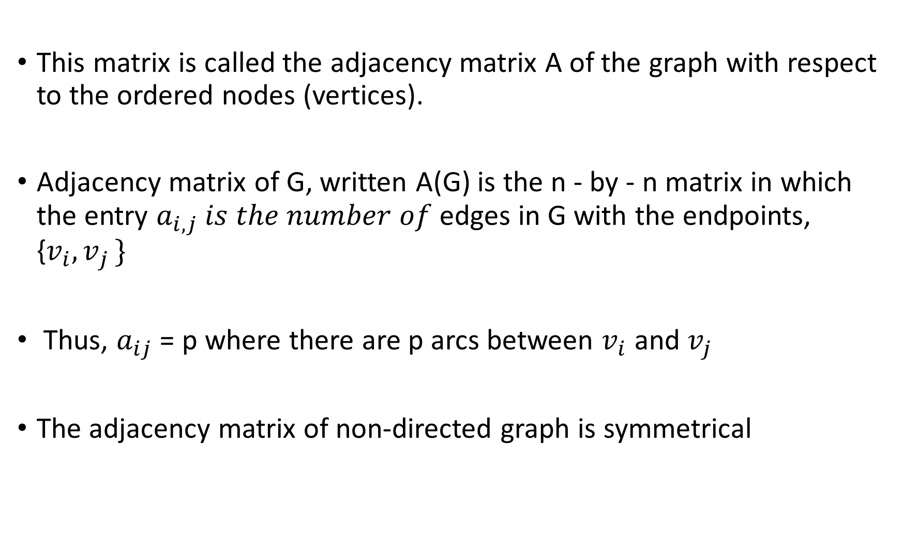
This matrix is called the adjacency matrix A of the graph with respect to the ordered nodes (vertices).
Adjacency matrix of G, written A(G) is the n - by - n matrix in which the entry $a_{i,j} is the number of$edges in G with the endpoints, {$v_{i}{, v}_{j}\}$
Thus, $a_{ij}$ = p where there are p arcs between $v_{i}$ and $v_{j}$
The adjacency matrix of non-directed graph is symmetrical

Slide 38

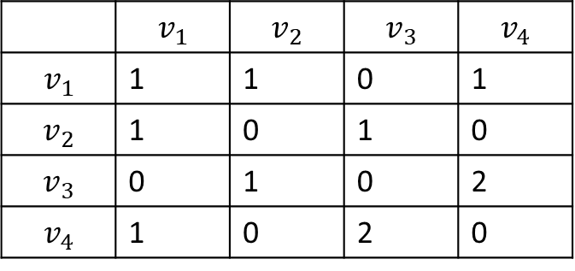




Example 4
Lets construct an adjacency matrix for the graph, G= (V, E) below:
V = ($v_{1},v_{2}{,v_{3},v}_{4}$)
The adjacency matrix of G is given by:
$$v_{1}$$
$$v_{3}$$
$$v_{2}$$
$$v_{4}$$
 | $$v_{1}$$ | $$v_{2}$$ | $$v_{3}$$ | $$v_{4}$$
$$v_{1}$$ | 1 | 1 | 0 | 1
$$v_{2}$$ | 1 | 0 | 1 | 0
$$v_{3}$$ | 0 | 1 | 0 | 2
$$v_{4}$$ | 1 | 0 | 2 | 0

Slide 39


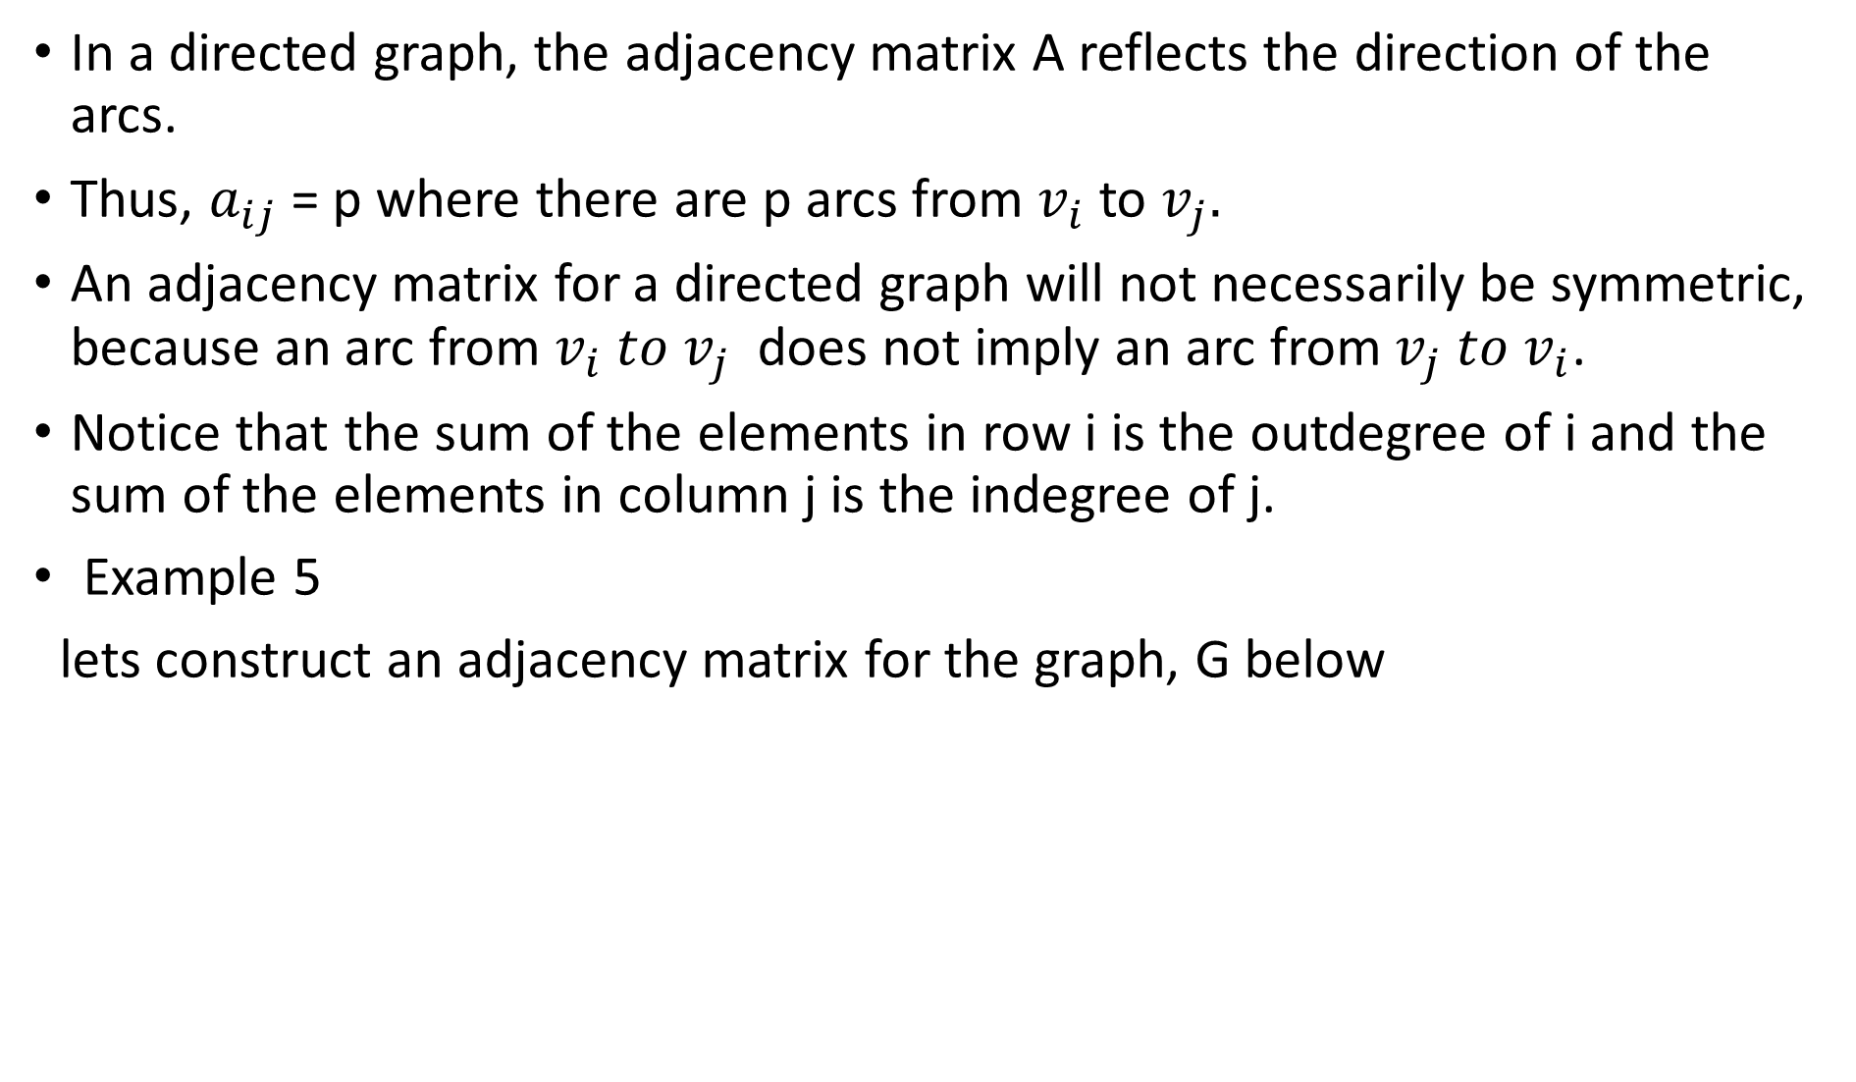



In a directed graph, the adjacency matrix A reflects the direction of the arcs.
Thus, $a_{ij}$ = p where there are p arcs from $v_{i}$ to $v_{j}.$
An adjacency matrix for a directed graph will not necessarily be symmetric, because an arc from $v_{i} to v_{j}$ does not imply an arc from $v_{j} to v_{i}$.
Notice that the sum of the elements in row i is the outdegree of i and the sum of the elements in column j is the indegree of j.
Example 5
lets construct an adjacency matrix for the graph, G below
$$v_{2}$$
$$v_{3}$$
$$v_{5}$$
$$v_{4}$$
$v_{1}$

Slide 40
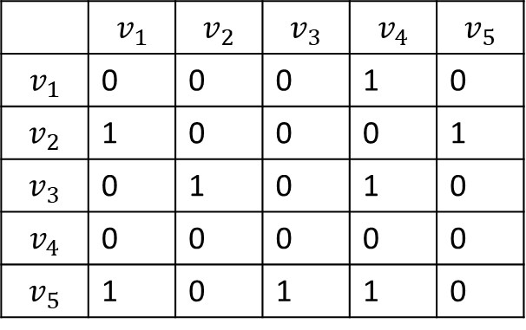
The main principal diagonal entries are zero since there is no self-loop
In a simple weighted graph, the entries in the adjacency matrix can indicate the weight of an arc by the appropriate number rather than just indicating the presence of an arc by the number 1
 | $$v_{1}$$ | $$v_{2}$$ | $$v_{3}$$ | $$v_{4}$$ | $$v_{5}$$
$$v_{1}$$ | 0 | 0 | 0 | 1 | 0
$$v_{2}$$ | 1 | 0 | 0 | 0 | 1
$$v_{3}$$ | 0 | 1 | 0 | 1 | 0
$$v_{4}$$ | 0 | 0 | 0 | 0 | 0
$$v_{5}$$ | 1 | 0 | 1 | 1 | 0

Slide 41
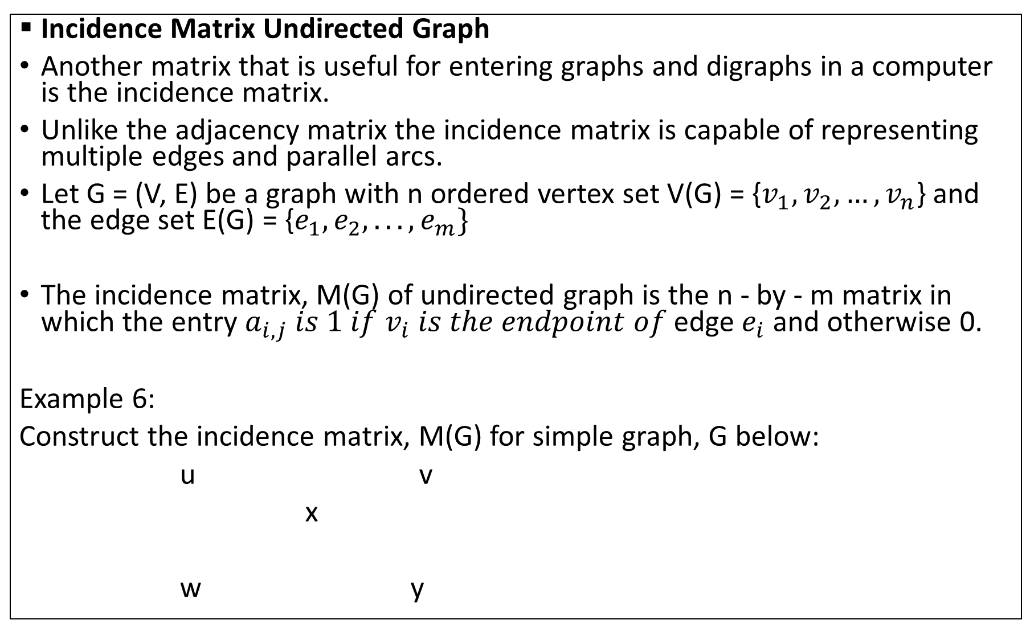
Incidence Matrix Undirected Graph
Another matrix that is useful for entering graphs and digraphs in a computer is the incidence matrix.
Unlike the adjacency matrix the incidence matrix is capable of representing multiple edges and parallel arcs.
Let G = (V, E) be a graph with n ordered vertex set V(G) = {$v_{1},v_{2}{,…,v}_{n}$} and the edge set E(G) = {$e_{1}, e_{2}, . . . , e_{m}\}$
The incidence matrix, M(G) of undirected graph is the n - by - m matrix in which the entry $a_{i,j} is 1 if v_{i} is the endpoint of$edge $e_{i}$ and otherwise 0.
Example 6:
Construct the incidence matrix, M(G) for simple graph, G below:
u v
x
w y
f g
a
c d e
b

Slide 42
Solution
M(G)
 | a | b | c | d | e | f | g
u | 1 | 0 | 0 | 0 | 0 | 1 | 0
v | 0 | 0 | 0 | 1 | 1 | 0 | 1
w | 1 | 1 | 0 | 0 | 0 | 0 | 0
X | 0 | 1 | 1 | 0 | 0 | 1 | 1
y | 0 | 0 | 1 | 1 | 1 | 0 | 0

Slide 43





Example 7
lets construct an Incidence matrix for the graph, G below
$v_{2}$ d
$$v_{3}$$
a b c e
$$v_{5}$$
$${ f v}_{4}$$
i
$v_{1}$ g

Slide 44
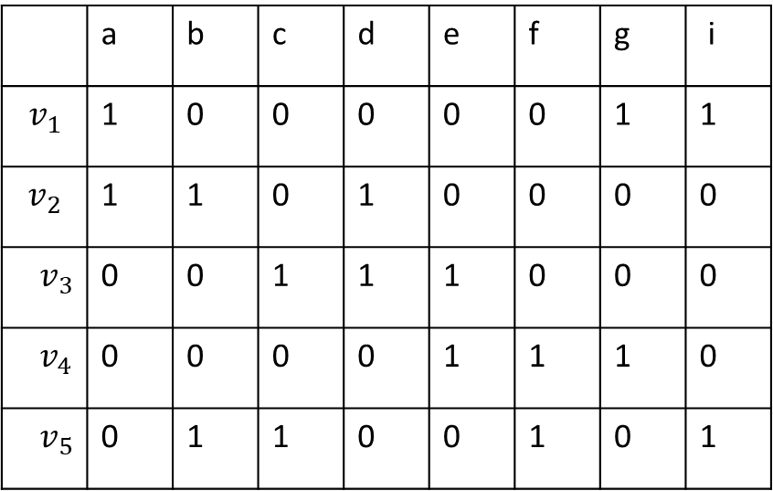
Solution
M(G)
 | a | b | c | d | e | f | g | i
$$v_{1}$$ | 1 | 0 | 0 | 0 | 0 | 0 | 1 | 1
$$v_{2}$$ | 1 | 1 | 0 | 1 | 0 | 0 | 0 | 0
$v_{3}$ | 0 | 0 | 1 | 1 | 1 | 0 | 0 | 0
$v_{4}$ | 0 | 0 | 0 | 0 | 1 | 1 | 1 | 0
$v_{5}$ | 0 | 1 | 1 | 0 | 0 | 1 | 0 | 1

Slide 45




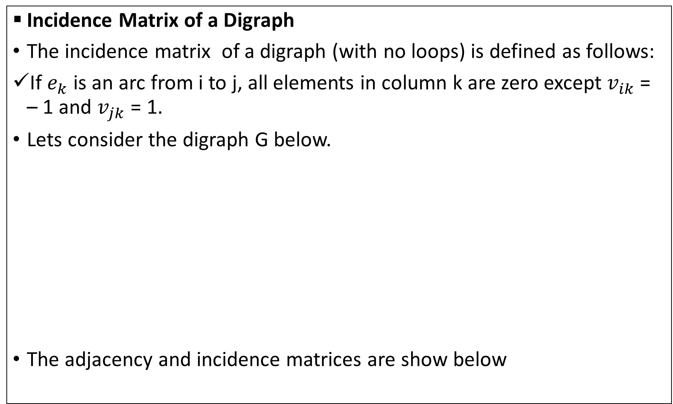






Incidence Matrix of a Digraph
The incidence matrix of a digraph (with no loops) is defined as follows:
If $e_{k}$ is an arc from i to j, all elements in column k are zero except $v_{ik}$ = – 1 and $v_{jk}$ = 1.
Lets consider the digraph G below.
The adjacency and incidence matrices are show below
$$v_{1}$$
$$e_{1}$$
$$v_{2}$$
$$e_{5}$$
$$e_{4}$$
$$e_{6}$$
$$e_{2}$$
$$v_{4}$$
$$v_{3}$$
$$e_{3}$$

Slide 46
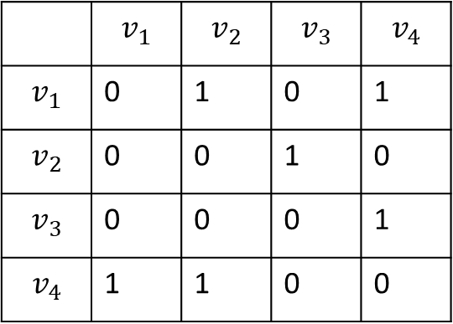
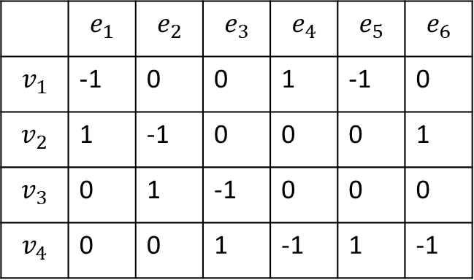
Solution
A(G) M(G)
 | $$v_{1}$$ | $$v_{2}$$ | $$v_{3}$$ | $$v_{4}$$
$$v_{1}$$ | 0 | 1 | 0 | 1
$$v_{2}$$ | 0 | 0 | 1 | 0
$$v_{3}$$ | 0 | 0 | 0 | 1
$$v_{4}$$ | 1 | 1 | 0 | 0
 | $$e_{1}$$ | $$e_{2}$$ | $$e_{3}$$ | $$e_{4}$$ | $$e_{5}$$ | $$e_{6}$$
$$v_{1}$$ | -1 | 0 | 0 | 1 | -1 | 0
$$v_{2}$$ | 1 | -1 | 0 | 0 | 0 | 1
$$v_{3}$$ | 0 | 1 | -1 | 0 | 0 | 0
$$v_{4}$$ | 0 | 0 | 1 | -1 | 1 | -1

Slide 47
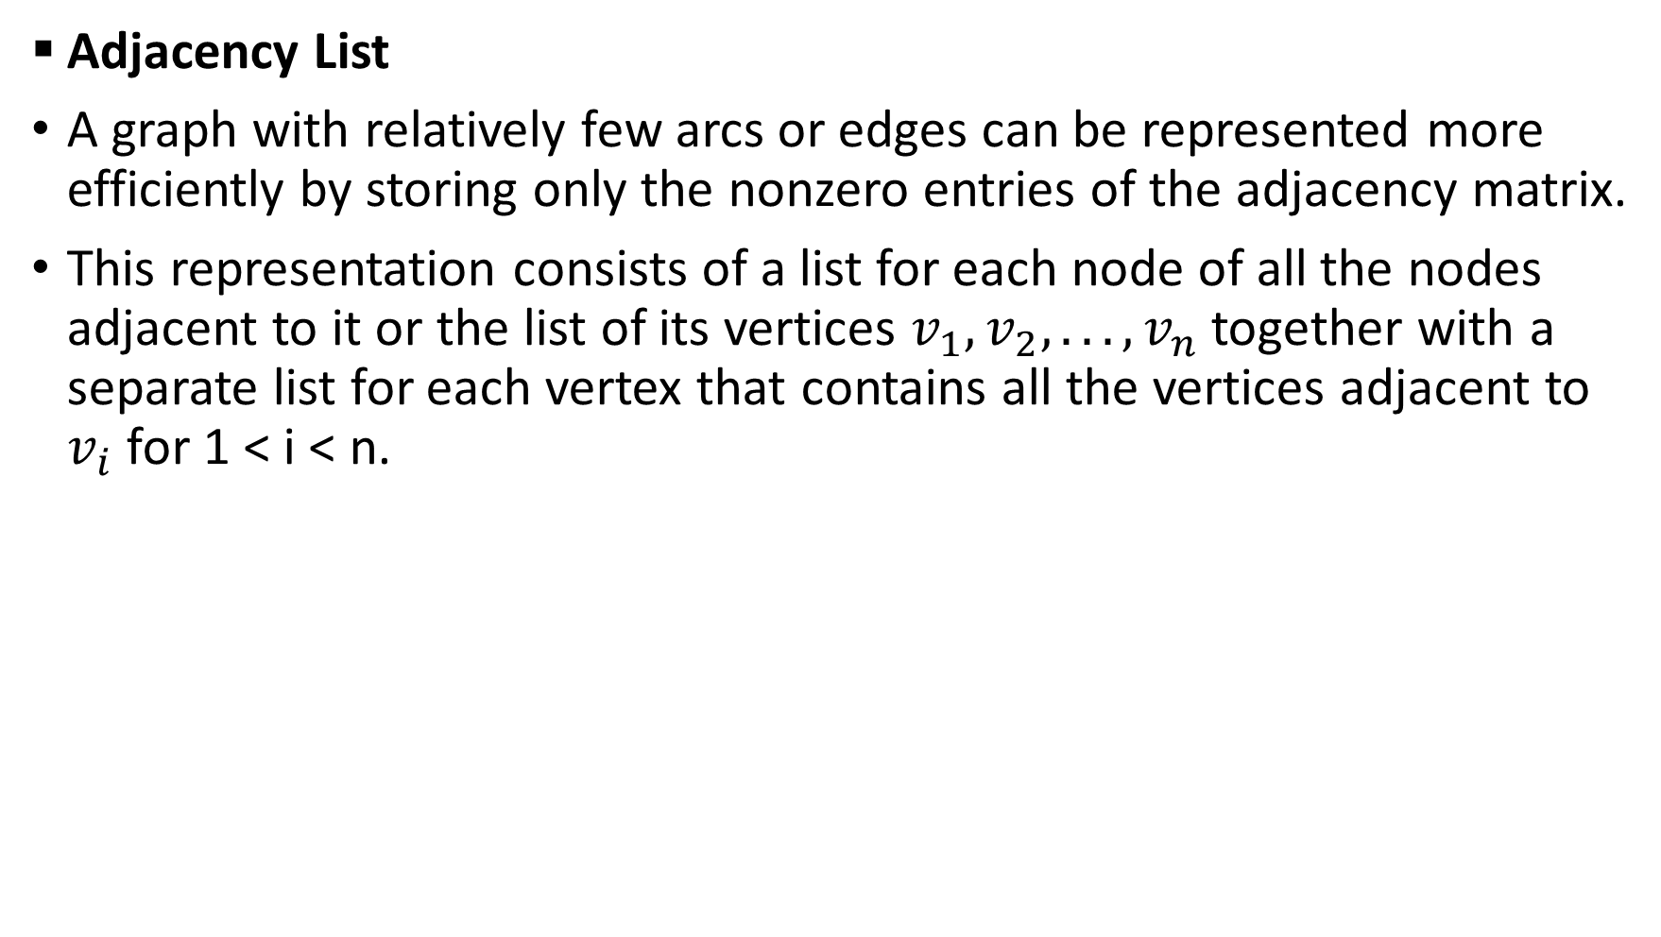
Adjacency List
A graph with relatively few arcs or edges can be represented more efficiently by storing only the nonzero entries of the adjacency matrix.
This representation consists of a list for each node of all the nodes adjacent to it or the list of its vertices $v_{1}, v_{2}, . . . , v_{n}$ together with a separate list for each vertex that contains all the vertices adjacent to $v_{i}$ for 1 < i < n.

Slide 48
Example 8
Construct the adjacency list of the ff graph below:
G H
B
2
1 2
1
A
11
6 9 10
C
4
7
3
F
8
3
E
5 4
D

Slide 49
Solution
Vertices |  | List of Adjacencies of H
A B C D E F |  | B C E F A C E A B D C E A B D F F F A E E E
Vertices |  | List of Adjacencies of G
1 2 3 4 |  | 1 3 4 3 4 4 1 2 1 2 2

Slide 50





Example 9
Construct an adjacency matrix, incidence matrix and adjacency list for the digraph below
G
b
$$v_{3}$$
$$v_{2}$$
e
c
d
$$v_{4}$$
$$v_{5}$$
a
f
g
$$v_{1}$$

Slide 51
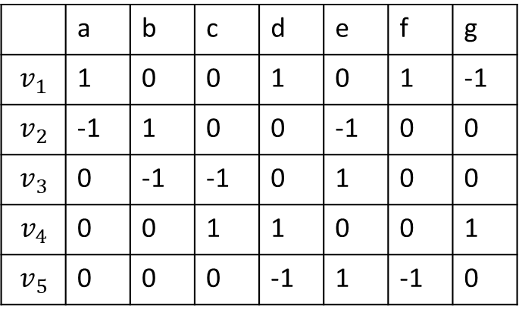
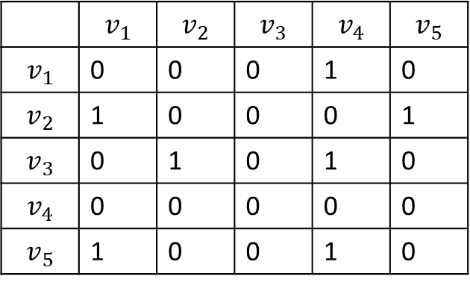
Solution
Adjacency Matrix, A(G) Incidence Matrix, M(G)
 | $$v_{1}$$ | $$v_{2}$$ | $$v_{3}$$ | $$v_{4}$$ | $$v_{5}$$
$$v_{1}$$ | 0 | 0 | 0 | 1 | 0
$$v_{2}$$ | 1 | 0 | 0 | 0 | 1
$$v_{3}$$ | 0 | 1 | 0 | 1 | 0
$$v_{4}$$ | 0 | 0 | 0 | 0 | 0
$$v_{5}$$ | 1 | 0 | 0 | 1 | 0
 | a | b | c | d | e | f | g
$$v_{1}$$ | 1 | 0 | 0 | 1 | 0 | 1 | -1
$$v_{2}$$ | -1 | 1 | 0 | 0 | -1 | 0 | 0
$$v_{3}$$ | 0 | -1 | -1 | 0 | 1 | 0 | 0
$$v_{4}$$ | 0 | 0 | 1 | 1 | 0 | 0 | 1
$$v_{5}$$ | 0 | 0 | 0 | -1 | 1 | -1 | 0

Slide 52
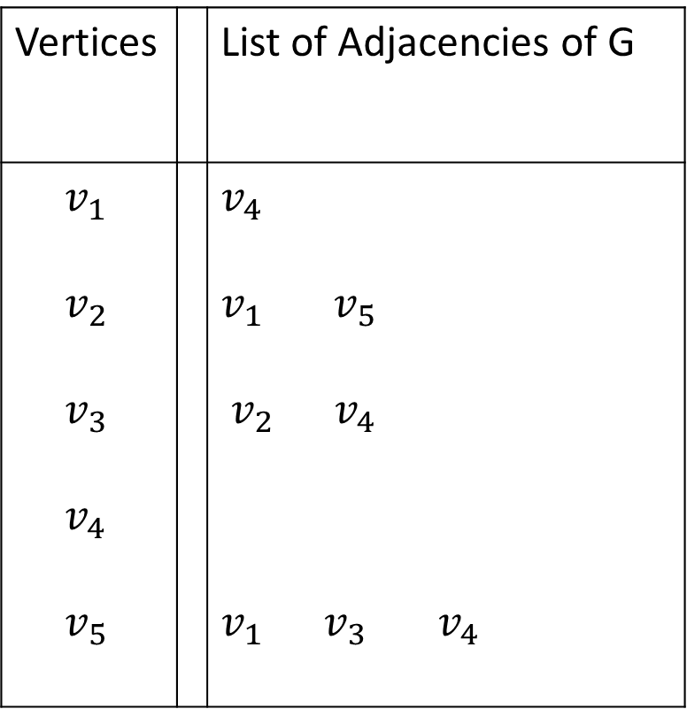
Solution
Vertices |  | List of Adjacencies of G
$v_{1}$ $v_{2}$ $v_{3}$ $v_{4}$ $v_{5}$ |  | $v_{4}$ $v_{1}$ $v_{5}$ $v_{2}$ $v_{4}$ $v_{1}$ $v_{3}$ $v_{4}$

Slide 53












Alternate: Adjacency Lists of weighted digraph
$$v_{1}$$
$$v_{4}$$
$$v_{2 }$$
$$v_{1}$$
$$v_{5}$$
$$v_{3}$$
$$v_{2}$$
$$v_{4}$$
$$v_{5}$$
$$v_{1}$$
$$v_{3}$$
$$v_{4}$$

Slide 54






Try:
Consider the two graphs below:
G w
H
x y z
Construct the ff for each graph:
Adjacency matrix
incidence matrix
Adjacency list.
$$v_{5}$$
$$v_{1}$$
e
1 2
f
k
d
a
$$v_{6}$$
j
3
5
g
5
i
$$v_{4}$$
4
$$v_{2}$$
b
c
$$v_{3}$$

Slide 55
Graph Transversal
Testing for Connectedness of a Graph
When a diagram of a graph is given, it can easily be identified whether the graph has more than one component (node, vertex) and thereby test its connectedness
Similarly, if we input a graph into a computer, we need an algorithm to check whether it is connected.
The algorithms to be considered here for connectedness are:
Depth-First Search (DFS) technique,
Breadth – First Search (BFS) technique.

Slide 56
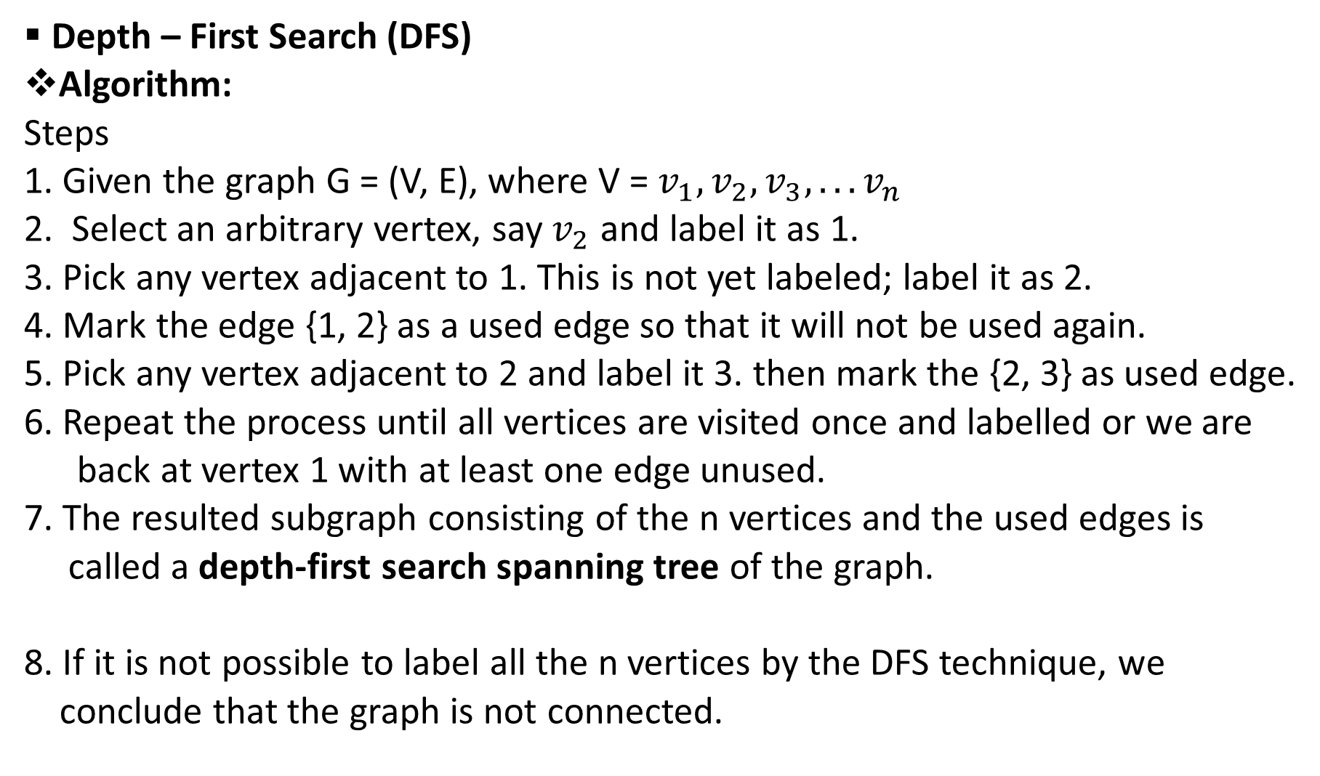
Depth – First Search (DFS)
Algorithm:
Steps
1. Given the graph G = (V, E), where V = $v_{1}, v_{2}, v_{3}, . . . v_{n}$
2. Select an arbitrary vertex, say $v_{2}$ and label it as 1.
3. Pick any vertex adjacent to 1. This is not yet labeled; label it as 2.
4. Mark the edge {1, 2} as a used edge so that it will not be used again.
5. Pick any vertex adjacent to 2 and label it 3. then mark the {2, 3} as used edge.
6. Repeat the process until all vertices are visited once and labelled or we are
back at vertex 1 with at least one edge unused.
7. The resulted subgraph consisting of the n vertices and the used edges is
called a depth-first search spanning tree of the graph.
8. If it is not possible to label all the n vertices by the DFS technique, we
conclude that the graph is not connected.

Slide 57








Consider the graph, G = (V, E) below:
Lets used the depth – first search (DFS) to check the connectedness of G and come out with the depth – first search spanning tree.
1
$$v_{1}$$
2
5
1
$$v_{2}$$
$$v_{3}$$
4
7
$$v_{6}$$
$$v_{4}$$
8
$$v_{8}$$
3
$$v_{7}$$
6
$$v_{5}$$

Slide 58
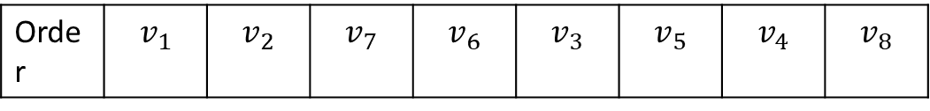
Depth – first search spanning tree.
DFS Nodes
$$v_{1}$$
$$v_{2}$$
$$v_{3}$$
$$v_{6}$$
$$v_{4}$$
$$v_{8}$$
$$v_{7}$$
$$v_{5}$$
Order | $$v_{1}$$ | $$v_{2}$$ | $$v_{7}$$ | $$v_{6}$$ | $$v_{3}$$ | $$v_{5}$$ | $$v_{4}$$ | $$v_{8}$$

Slide 59








Example 10
From the graph, G below,
(i) Construct the DFS spanning tree
(ii). List the DFS nodes
G
$$v_{1}$$
$$v_{3}$$
$$v_{2}$$
$$v_{7}$$
$$v_{6}$$
$$v_{8}$$
4
$$v_{5}$$
$$v_{4}$$

Slide 60








Solution:
i. Depth-first search spanning tree of the graph.
ii. DFS nodes
NB: If the total number of vertices of spanning tree is n, then the total
number of edges is n -1
$$v_{1}$$
$$v_{2}$$
$$v_{3}$$
$$v_{7}$$
$$v_{6}$$
$$v_{8}$$
4
$$v_{5}$$
$$v_{4}$$
Order | $$v_{1}$$ | $$v_{7}$$ | $$v_{5}$$ | $$v_{4}$$ | $$v_{8}$$ | $$v_{3}$$ | $$v_{2}$$ | $$v_{8}$$

Slide 61
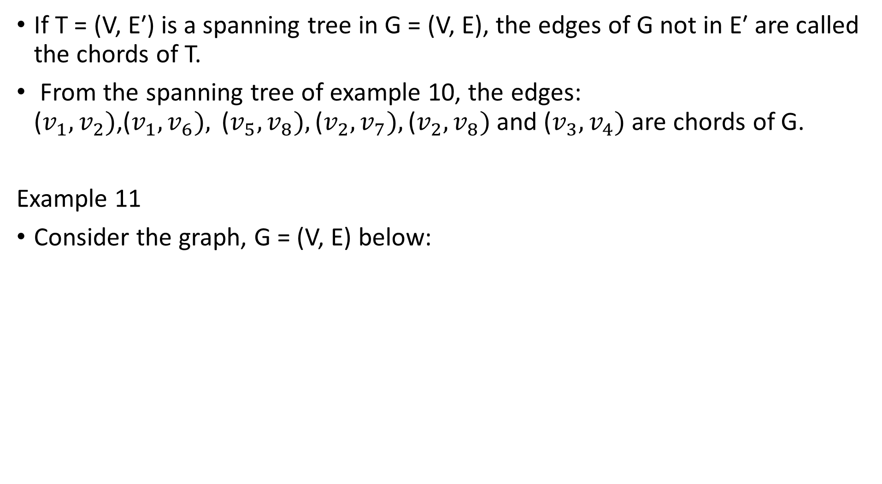
If T = (V, E′) is a spanning tree in G = (V, E), the edges of G not in E′ are called the chords of T.
From the spanning tree of example 10, the edges: ($v_{1}, v_{2})$,($v_{1}, v_{6}),$($v_{5}, v_{8}),\text{(}v_{2}, v_{7}),\text{(}v_{2}, v_{8})$and ($v_{3}, v_{4})$ are chords of G.
Example 11
Consider the graph, G = (V, E) below:
b
a
c
f
e
d

Slide 62
From the graph G above
(i) construct the DFS spanning tree and write down the DFS nodes
(ii) hence, state the chords
Spanning tree of G
DFS Nodes
ii. The chords are: (a, e), (a, f), (b, c), (d, f), (b, d)
Solution
6
1
c
2
a
b
i
3
f
5
e
4
d
Order | a | b | f | e | d | c

Slide 63





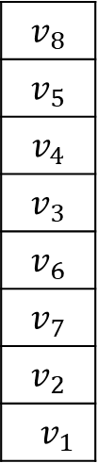



Using Stack Approach for DFS:
Example 12
write down the DFS nodes
DFS Nodes Stack
Results:-
NB: the process is completed when the stack is empty
$$v_{1}$$
$$v_{8}$$
$$v_{5}$$
$$v_{4}$$
$$v_{3}$$
$$v_{6}$$
$$v_{7}$$
$$v_{2}$$
$v_{1}$
$$v_{2}$$
$$v_{3}$$
$$v_{6}$$
$$v_{4}$$
$$v_{8}$$
$$v_{5}$$
$$v_{7}$$
$$v_{1}$$ | $$v_{2}$$ | $$v_{7}$$ | $$v_{6}$$ | $$v_{3}$$ | $$v_{4}$$ | $$v_{5}$$ | $$v_{8}$$

Slide 64
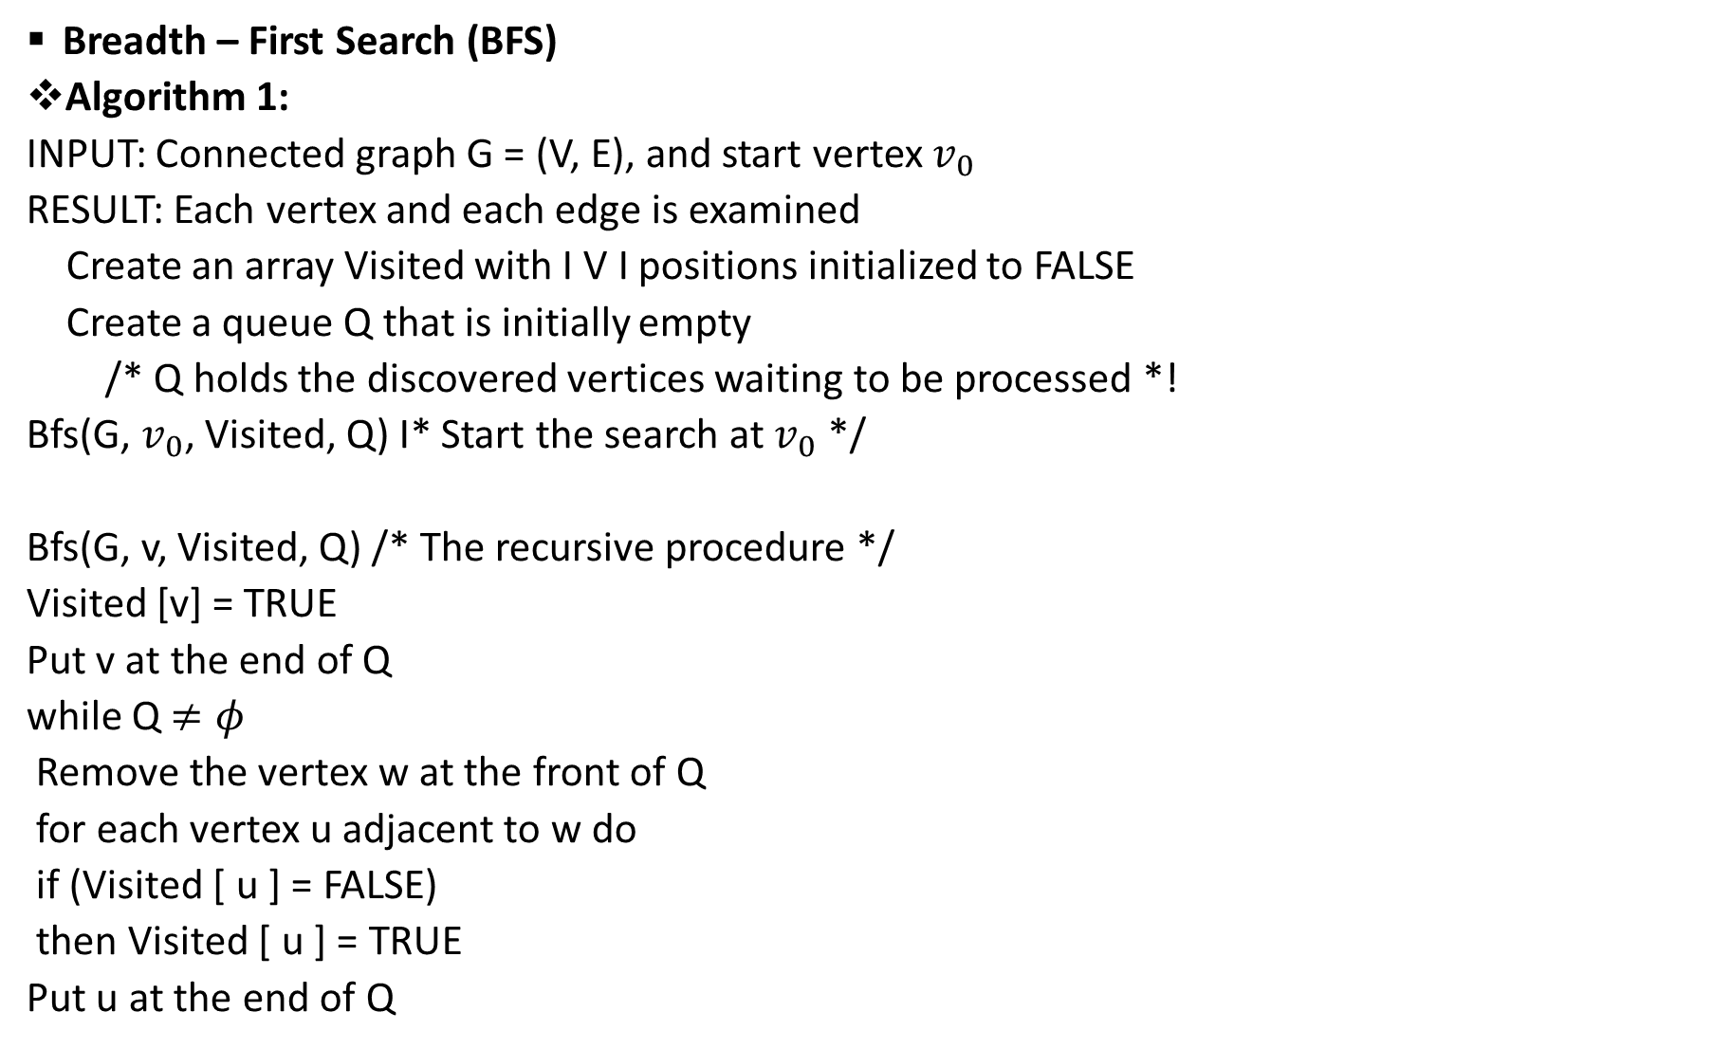
Breadth – First Search (BFS)
Algorithm 1:
INPUT: Connected graph G = (V, E), and start vertex $v_{0}$
RESULT: Each vertex and each edge is examined
Create an array Visited with I V I positions initialized to FALSE
Create a queue Q that is initially empty
/* Q holds the discovered vertices waiting to be processed *!
Bfs(G, $v_{0}$, Visited, Q) I* Start the search at $v_{0}$ */
Bfs(G, v, Visited, Q) /* The recursive procedure */
Visited [v] = TRUE
Put v at the end of Q
while Q $≠φ$
Remove the vertex w at the front of Q
for each vertex u adjacent to w do
if (Visited [ u ] = FALSE)
then Visited [ u ] = TRUE
Put u at the end of Q

Slide 65
Algorithm 2 for BFS:
BreadthFirst(simple, connected graph G; node a);
//writes nodes in graph G in breadth first order from node a
Local Variable:
queue of nodes Q
initialize Q to be empty
mark a visited
write(a)
enqueuer (a, Q)
while Q is not empty do
for each node n adjacent to front(Q) do
if n not visited then
mark n visited
write(n)
enqueuer (n, Q)
end if
end for
dequeuer (Q)
end while
end BreadthFirst

Slide 66


Example 13
Consider the graph, G below:
Use BFS to check for connectedness
i. construct the BFS spanning tree
ii. Hence write down the BFS nodes
iii. State the chords of G
$$v_{1}$$
$$v_{2}$$
$$v_{3}$$
$$v_{6}$$
$$v_{4}$$
$$v_{8}$$
$$v_{5}$$
$$v_{7}$$

Slide 67
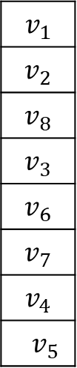

solution
i. BFS Spanning Tree
BFS Nodes Queue
ii Results:-
NB: the process is completed when the queue is empty
iii. The chords are: ($v_{3}$, $v_{6})$, ($v_{7}$, $v_{8})$, ($v_{6}$, $v_{7})$
$$v_{1}$$
$$v_{2}$$
$$v_{3}$$
$$v_{1}$$
$$v_{2}$$
$$v_{8}$$
$$v_{3}$$
$$v_{6}$$
$$v_{7}$$
$$v_{4}$$
$v_{5}$
$$v_{6}$$
$$v_{4}$$
$$v_{8}$$
$$v_{5}$$
$$v_{7}$$
$$v_{1}$$ | $$v_{2}$$ | $$v_{8}$$ | $$v_{3}$$ | $$v_{6}$$ | $$v_{7}$$ | $$v_{4}$$ | $$v_{5}$$

Slide 68
Example 14
From the graph, G below,
i. construct the BFS spanning tree
ii. write down the BFS nodes
G
1
3
2
7
6
8
4
5
4

Slide 69
Solution
i.
G
BFS Spanning Tree
ii. BFS Nodes
Results:- Queue
1
2
3
7
1
2
6
7
3
8
5
4
6
8
4
5
4
1 | 2 | 6 | 7 | 7 | 8 | 5 | 4

Slide 70
Example 15
Consider the graph, G = (V, E) below:
Use BFS to check for connectedness
construct the BFS spanning tree
write down the BFS nodes
State the chords
a
b
c
f
e
d

Slide 71
Solution
BFS Spanning Tree
i.
Queue
ii. BFS Nodes
Result:-
iii. The chord are: (b, f), (c, d), (d, f), (e, f), (d, e)
a
b
c
f
d
e
a
b
e
f
c
d
a | b | e | f | c | d

Slide 72







Exercises
From the graph, G below,
Determine the following: (i) order (ii) size of G
Show that, $\sum_{i=1}^{5}{\deg{i}}$= 2m, where m is the size of G
G
1
$$e_{1}$$
2
$$e_{5}$$
$$e_{3}$$
$$e_{4}$$
5
$$e_{2}$$
4
4
3
$$e_{6}$$

Slide 73
















2. From the graph, G below,
Construct the following: (i) adjacency matrix (ii) incidence matrix
(iii) adjacency list
G
1
$$e_{1}$$
$$e_{2}$$
2
3
$$e_{12}$$
$$e_{11}$$
$$e_{17}$$
$$e_{3}$$
$$e_{7}$$
$$e_{16}$$
8
$$e_{8}$$
$$e_{10}$$
$$e_{15}$$
4
7
$$e_{9}$$
9
4
$$e_{14}$$
$$e_{4}$$
$$e_{6}$$
$$e_{13}$$
6
$$e_{5}$$
5

Slide 74
3. From the graph, G below, construct
(i) DFS Spanning Tree and write down DFS Nodes
(ii) BFS Spanning Tree and write down the BFS Nodes
G
1
2
3
7
6
8
4
5
4

Slide 75
Minimum Spanning Tree
Let‘s consider the weighted graph G with n number of vertices.
In this case, all the possible spanning tree have n – 1 number of edges or size.
The idea is find the spanning tree with the lest or minimum weight.
The algorithm be considered here are the Kruskal algorithm and Prims algorithm.

Slide 76
Kruskal Algorithm for Minimum Spanning Tree:
Inputs: The connected weighted graph, G
Idea: Maintain an acyclic subgraph of G; enlarge it with an adjacent
edge with the lest weight to form the spanning tree.
Consider edges in an ascending order of weights.
Steps:
1: Arrange the edges of G in order of increasing weights and select
the edge with minimum weight.
2: Proceed sequentially, add each edge which does not result in
a cycle until n – 1, edges are selected.
3: Exit.

Slide 77
Example 15:
Consider the weighted graph G below:
construct the minimum spanning tree using Kruskal algorithm
a
b
12
9
4
c
d
5
7
8
11
11
5
e
f

Slide 78
Solution:
The weight of the minimum spanning tree is 4 + 5 + 5 + 8 +11 = 33
We have n – 1 edges: thus 6 vertices and 5 edges
Edges | (b, d) | (d, f) | (a, e) | (e, c) | (f, a)
Weight | 4 | 5 | 5 | 8 | 11
b
4
c
a
d
8
5
11
5
e
f

Slide 79
Example 16
From the graph, G below,
(i) find the minimum spanning weight using Kruskal algorithm
(ii) Hence construct the minimum Spanning tree
G
7
2
3
3
1
4
6
8
5
7
8
7
8
9
5
8
6
4
4
4
6
5
5
4

Slide 80
Solution
i.
The weight of the minimum spanning tree = 3 + 4 + 4 +5 + 5 + 8 = 29
G
We have n – 1 edges: thus 7 vertices and 6 edges
Edges | (2, 3) | (5, 6) | (1, 7) | (6, 1) | (4, 5) | (3, 4)
Weights | 3 | 4 | 4 | 5 | 5 | 8
1
2
3
3
4
5
7
8
6
4
4
5
5
4

Slide 81
Prims Algorithm for Minimum Spanning Tree:
Inputs: The connected weighted graph, G
Idea: Maintain an acyclic subgraph of G; grow the spanning tree from a
given vertex with the lest weight; iteratively adding the lest edge
from a vertex already reached to a vertex not yet reach; finish
the iteration when all vertices are reached. (Tier should be broken
arbitrary)

Slide 82
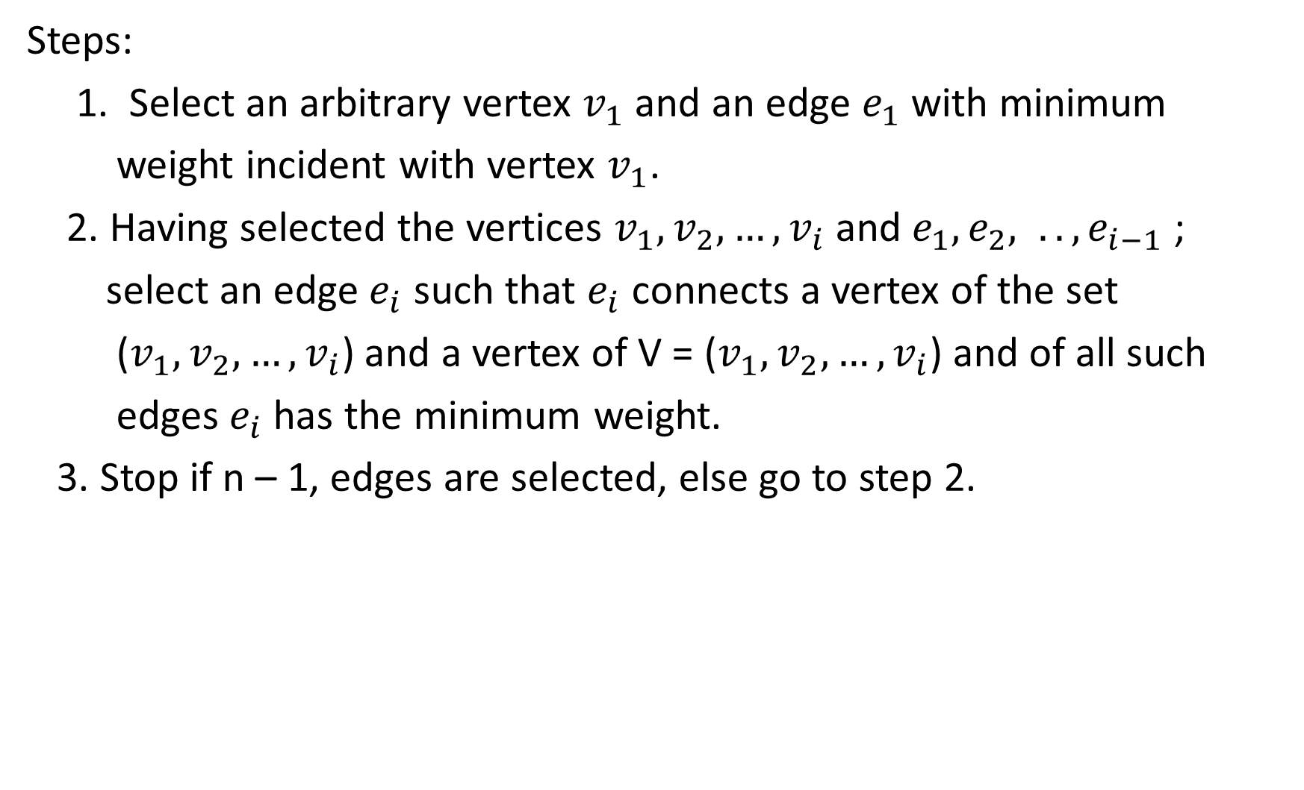
Steps:
1. Select an arbitrary vertex $v_{1}$ and an edge $e_{1}$ with minimum
weight incident with vertex $v_{1}$.
2. Having selected the vertices $v_{1}, v_{2}, {…, v}_{i}$and $e_{1}, e_{2}, .., e_{i−1}$ ;
select an edge $e_{i}$ such that $e_{i}$ connects a vertex of the set
($v_{1}, v_{2}, {…, v}_{i}$) and a vertex of V = ($v_{1}, v_{2}, {…, v}_{i}$) and of all such
edges $e_{i}$ has the minimum weight.
3. Stop if n – 1, edges are selected, else go to step 2.

Slide 83






Example 15:
Consider the weighted graph G below:
construct the minimum spanning tree using Prims algorithm
$$v_{1}$$
$$v_{4}$$
12
9
4
$$v_{2}$$
$$v_{5}$$
5
7
8
11
11
5
$$v_{3}$$
$$v_{6}$$

Slide 84

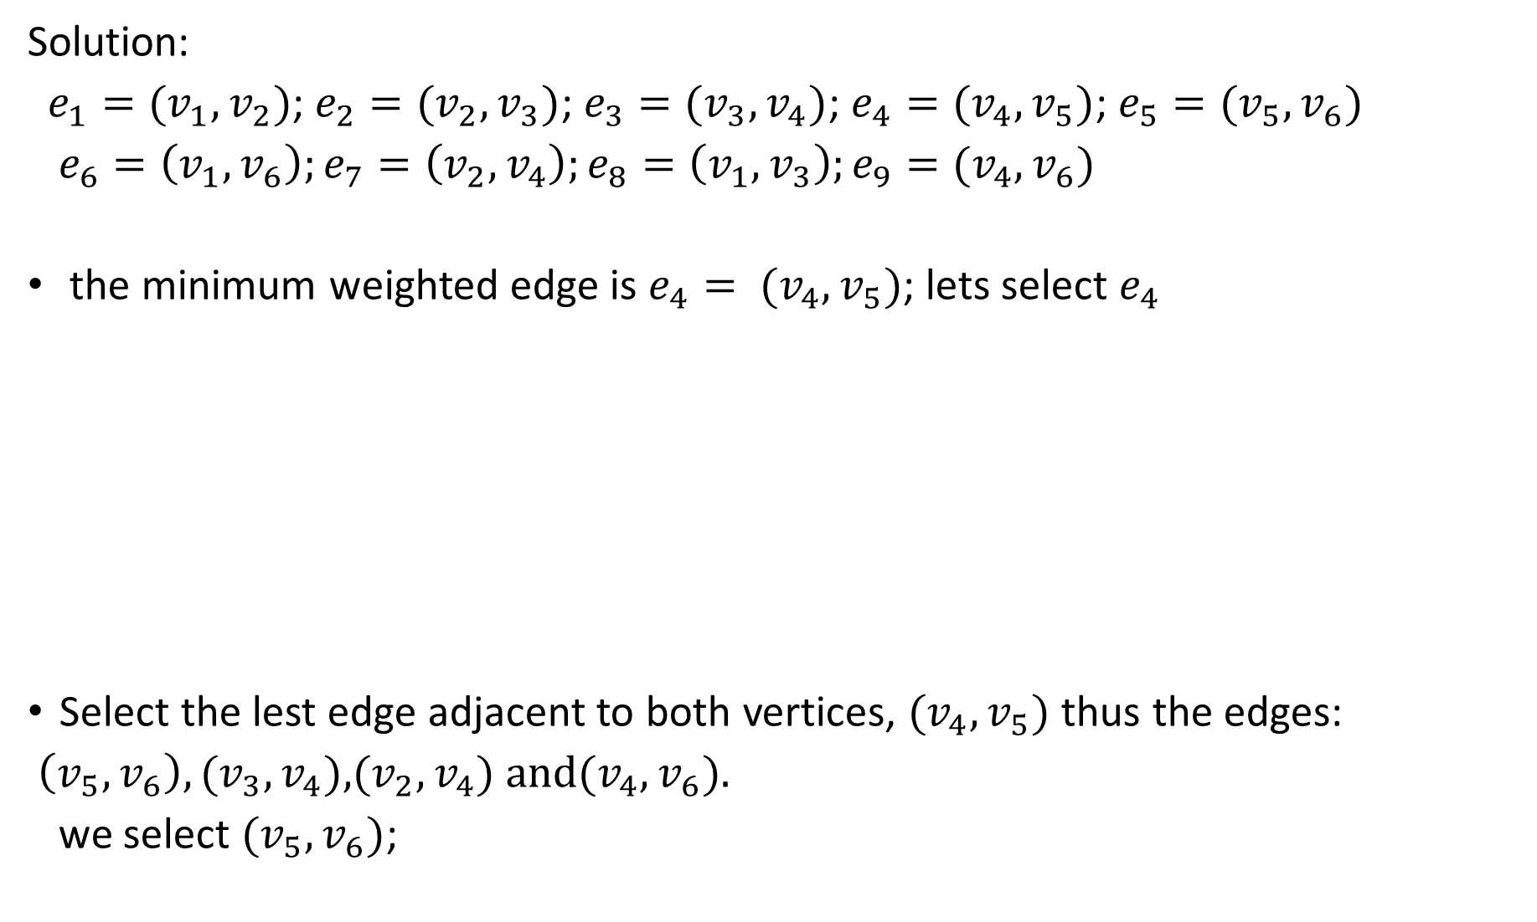

Solution:
$e_{1}=(v_{1}, v_{2})$; $e_{2}=(v_{2}, v_{3})$; $e_{3}=(v_{3}, v_{4})$; $e_{4}=(v_{4}, v_{5})$; $e_{5}=(v_{5}, v_{6})$
$e_{6}=\left(v_{1}, v_{6}\right);e_{7}=\left(v_{2}, v_{4}\right);e_{8}=\left(v_{1}, v_{3}\right);e_{9}=(v_{4}, v_{6})$
the minimum weighted edge is $e_{4}= (v_{4}, v_{5})$; lets select $e_{4}$
Select the lest edge adjacent to both vertices, $(v_{4}, v_{5})$ thus the edges:
$\left(v_{5}, v_{6}\right),(v_{3}, v_{4})\text{,}(v_{2}, v_{4}) \text{and}(v_{4}, v_{6})\text{.}$
we select $(v_{5}, v_{6})$;
$$v_{4}$$
4
$$v_{5}$$

Slide 85



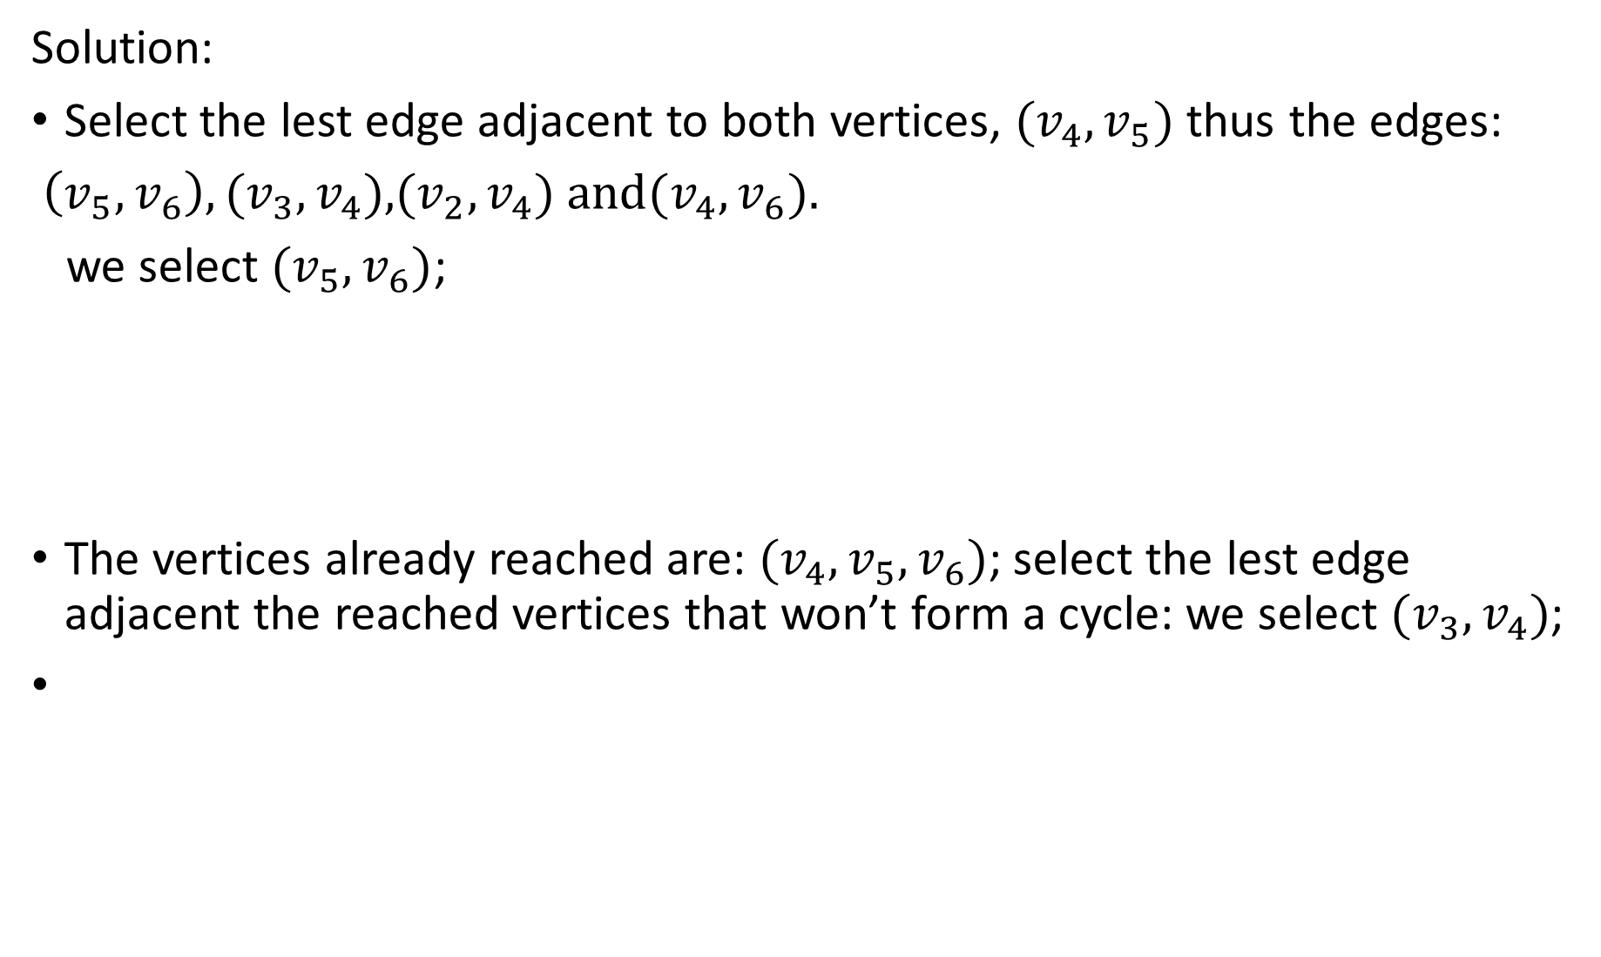




Solution:
Select the lest edge adjacent to both vertices, $(v_{4}, v_{5})$ thus the edges:
$\left(v_{5}, v_{6}\right),(v_{3}, v_{4})\text{,}(v_{2}, v_{4}) \text{and}(v_{4}, v_{6})\text{.}$
we select $(v_{5}, v_{6})$;
The vertices already reached are: $({v_{4},v}_{5}, v_{6})$; select the lest edge adjacent the reached vertices that won’t form a cycle: we select $(v_{3}, v_{4})$;
$$v_{4}$$
4
$$v_{6}$$
5
$$v_{5}$$
$$v_{4}$$
11
4
$$v_{3}$$
$v_{6}$
5
$$v_{5}$$

Slide 86






The iteration continue and we have:
The vertices already reached are: $({{v_{3},v}_{4},v}_{5}, v_{6})$;
$({{{v_{1}, v}_{3},v}_{4},v}_{5}, v_{6})$
$({{{v_{1}, v_{2},v}_{3},v}_{4},v}_{5}, v_{6})$; All the vertices are reached, we stop.
$$v_{1}$$
$$v_{4}$$
5
11
4
$$v_{3}$$
5
$$v_{5}$$
$$v_{6}$$
$$v_{1}$$
$$v_{2}$$
$$v_{4}$$
8
5
11
4
$$v_{3}$$
$v_{6}$
5
$$v_{5}$$

Slide 87
The weight of the minimum spanning tree is 4 + 5 + 5 + 8 +11 = 33
NB: number vertices (n) is 6 and number edges is 5 thus ( n – 1)

Slide 88
Example 16
From the graph, G below,
(i) find the minimum spanning weight using Prims algorithm
(ii) Hence construct the minimum Spanning tree
G
7
2
3
3
1
4
6
8
5
7
8
7
8
9
5
8
6
4
4
4
6
5
5
4

Slide 89
Solution:
Starting from the edge, (2, 3)
G
Reachable vertices: (1, 2, 3, 4, 5, 6, 7, 8)
Minimum spanning tree
The weight of the minimum spanning tree = 3 + 4 + 4 +4 + 5 + 6 + 6 = 32
2
3
3
1
4
6
5
7
6
4
8
4
6
5
4
4

